Slide 1
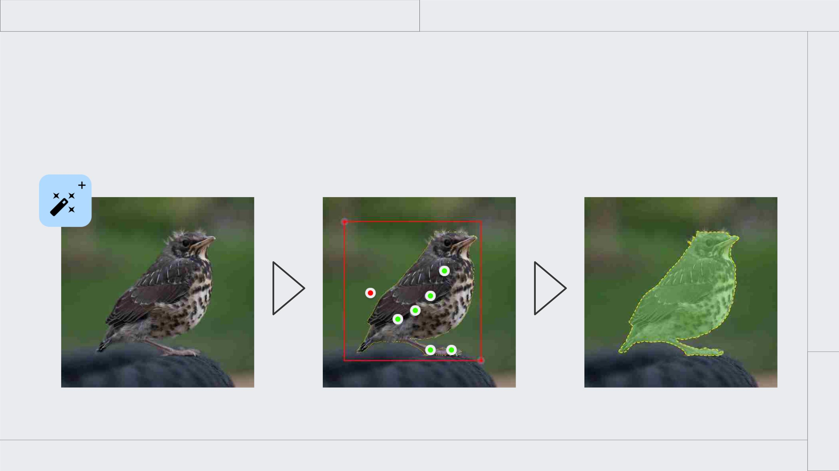
Serve Segment Anything Model
Interactive instance segmentation

Slide 2
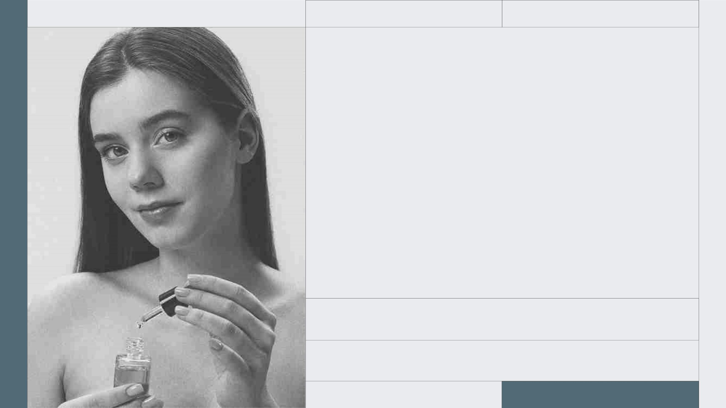
2XXX
TAKE CARE OF YOURSELF
SELFCARE
MORNING
ROUTINE
Here is where your presentation begins

Slide 3
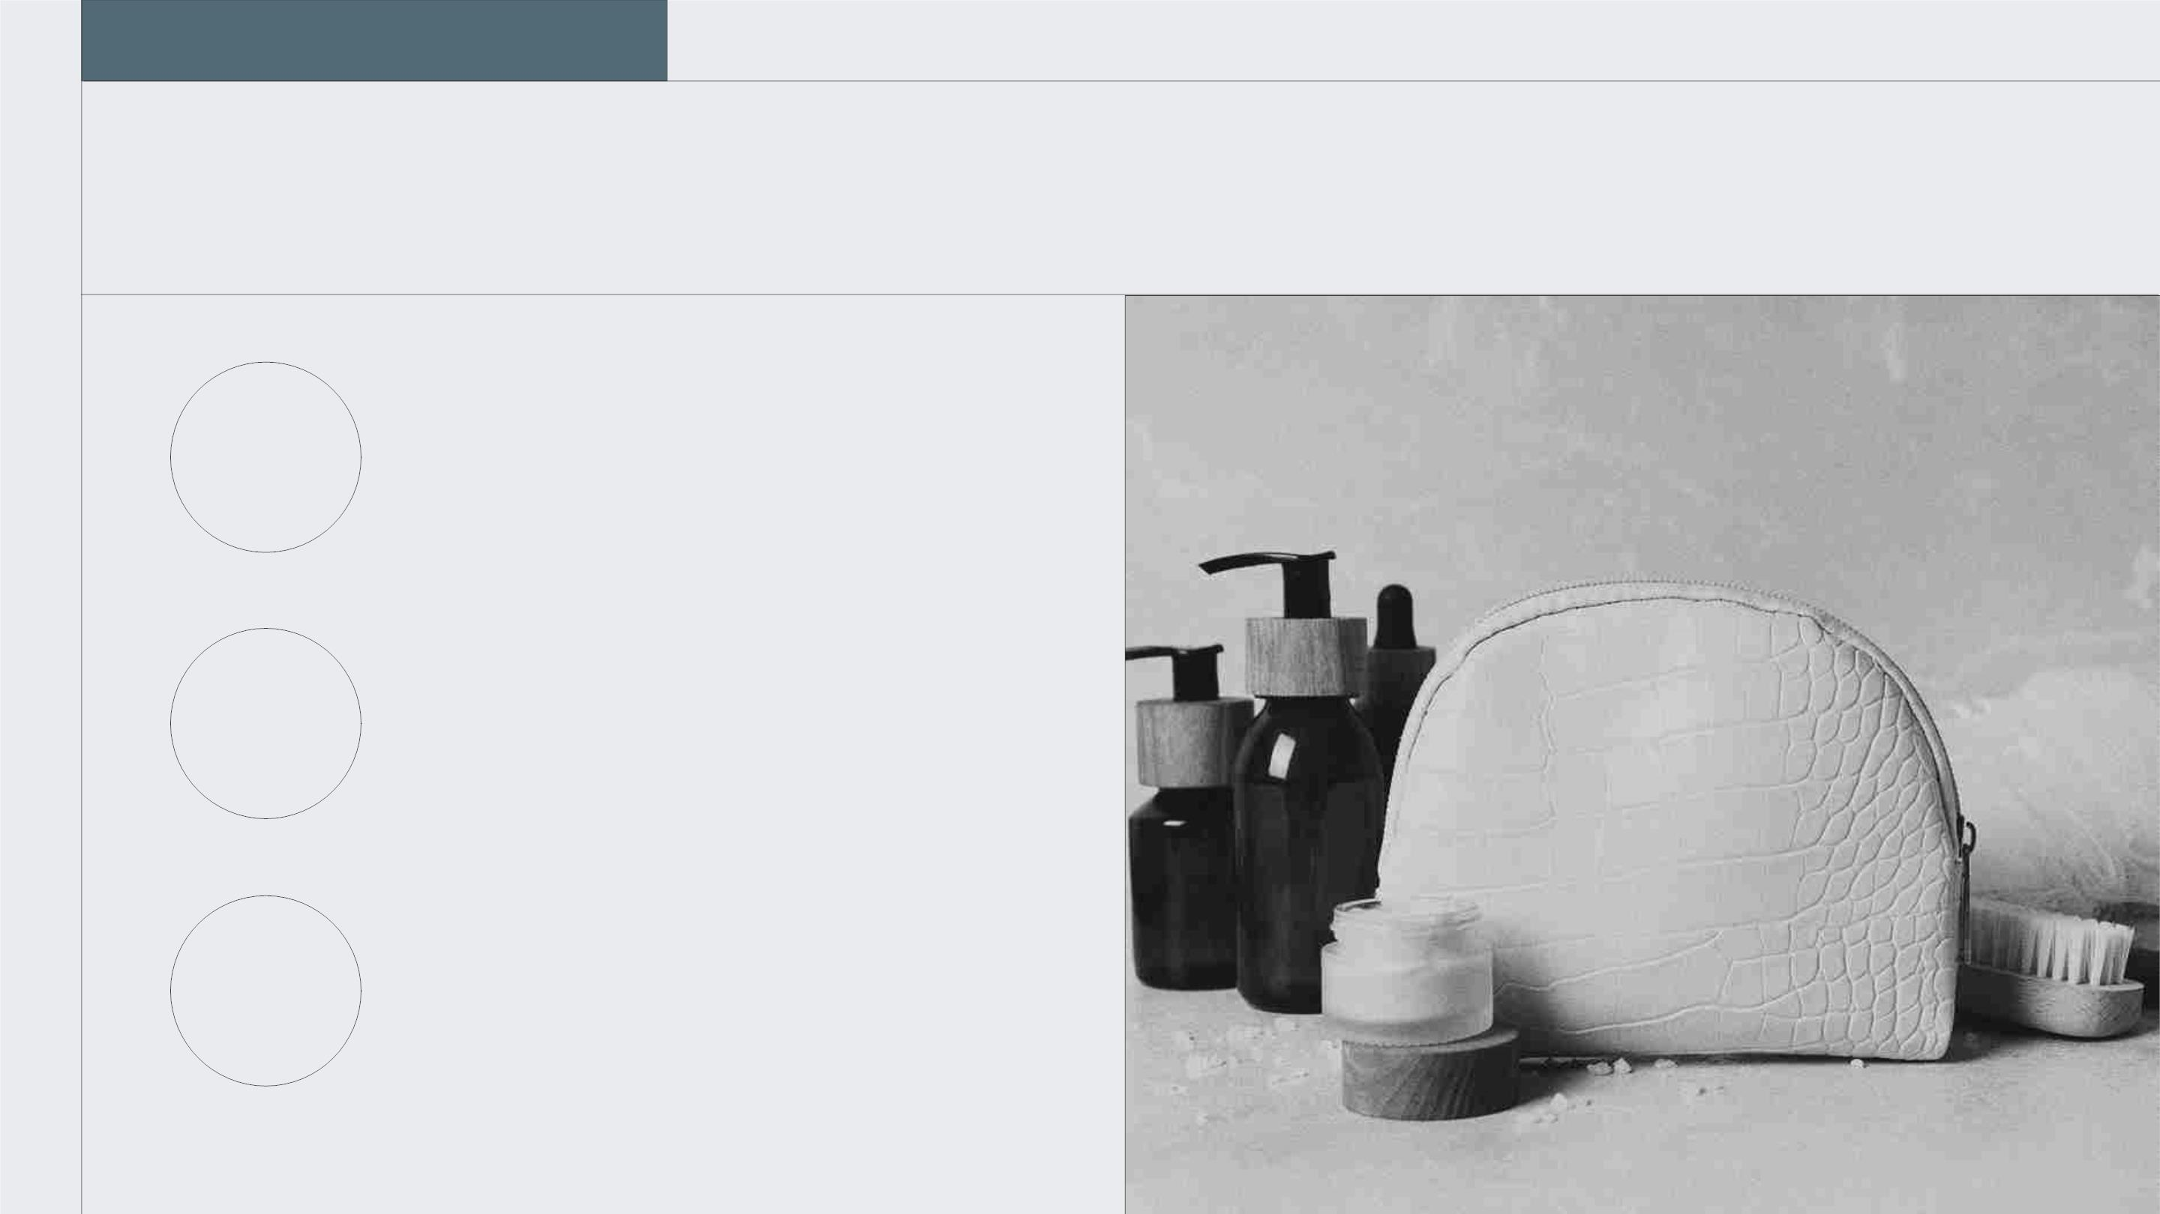
TABLE OF CONTENTS
SECTION 1
You can describe the
topic of the section
herec
SECTION 2
You can describe the
01
02
03
topic of the section here
SECTION 3
You can describe the
topic of the section here

Slide 4
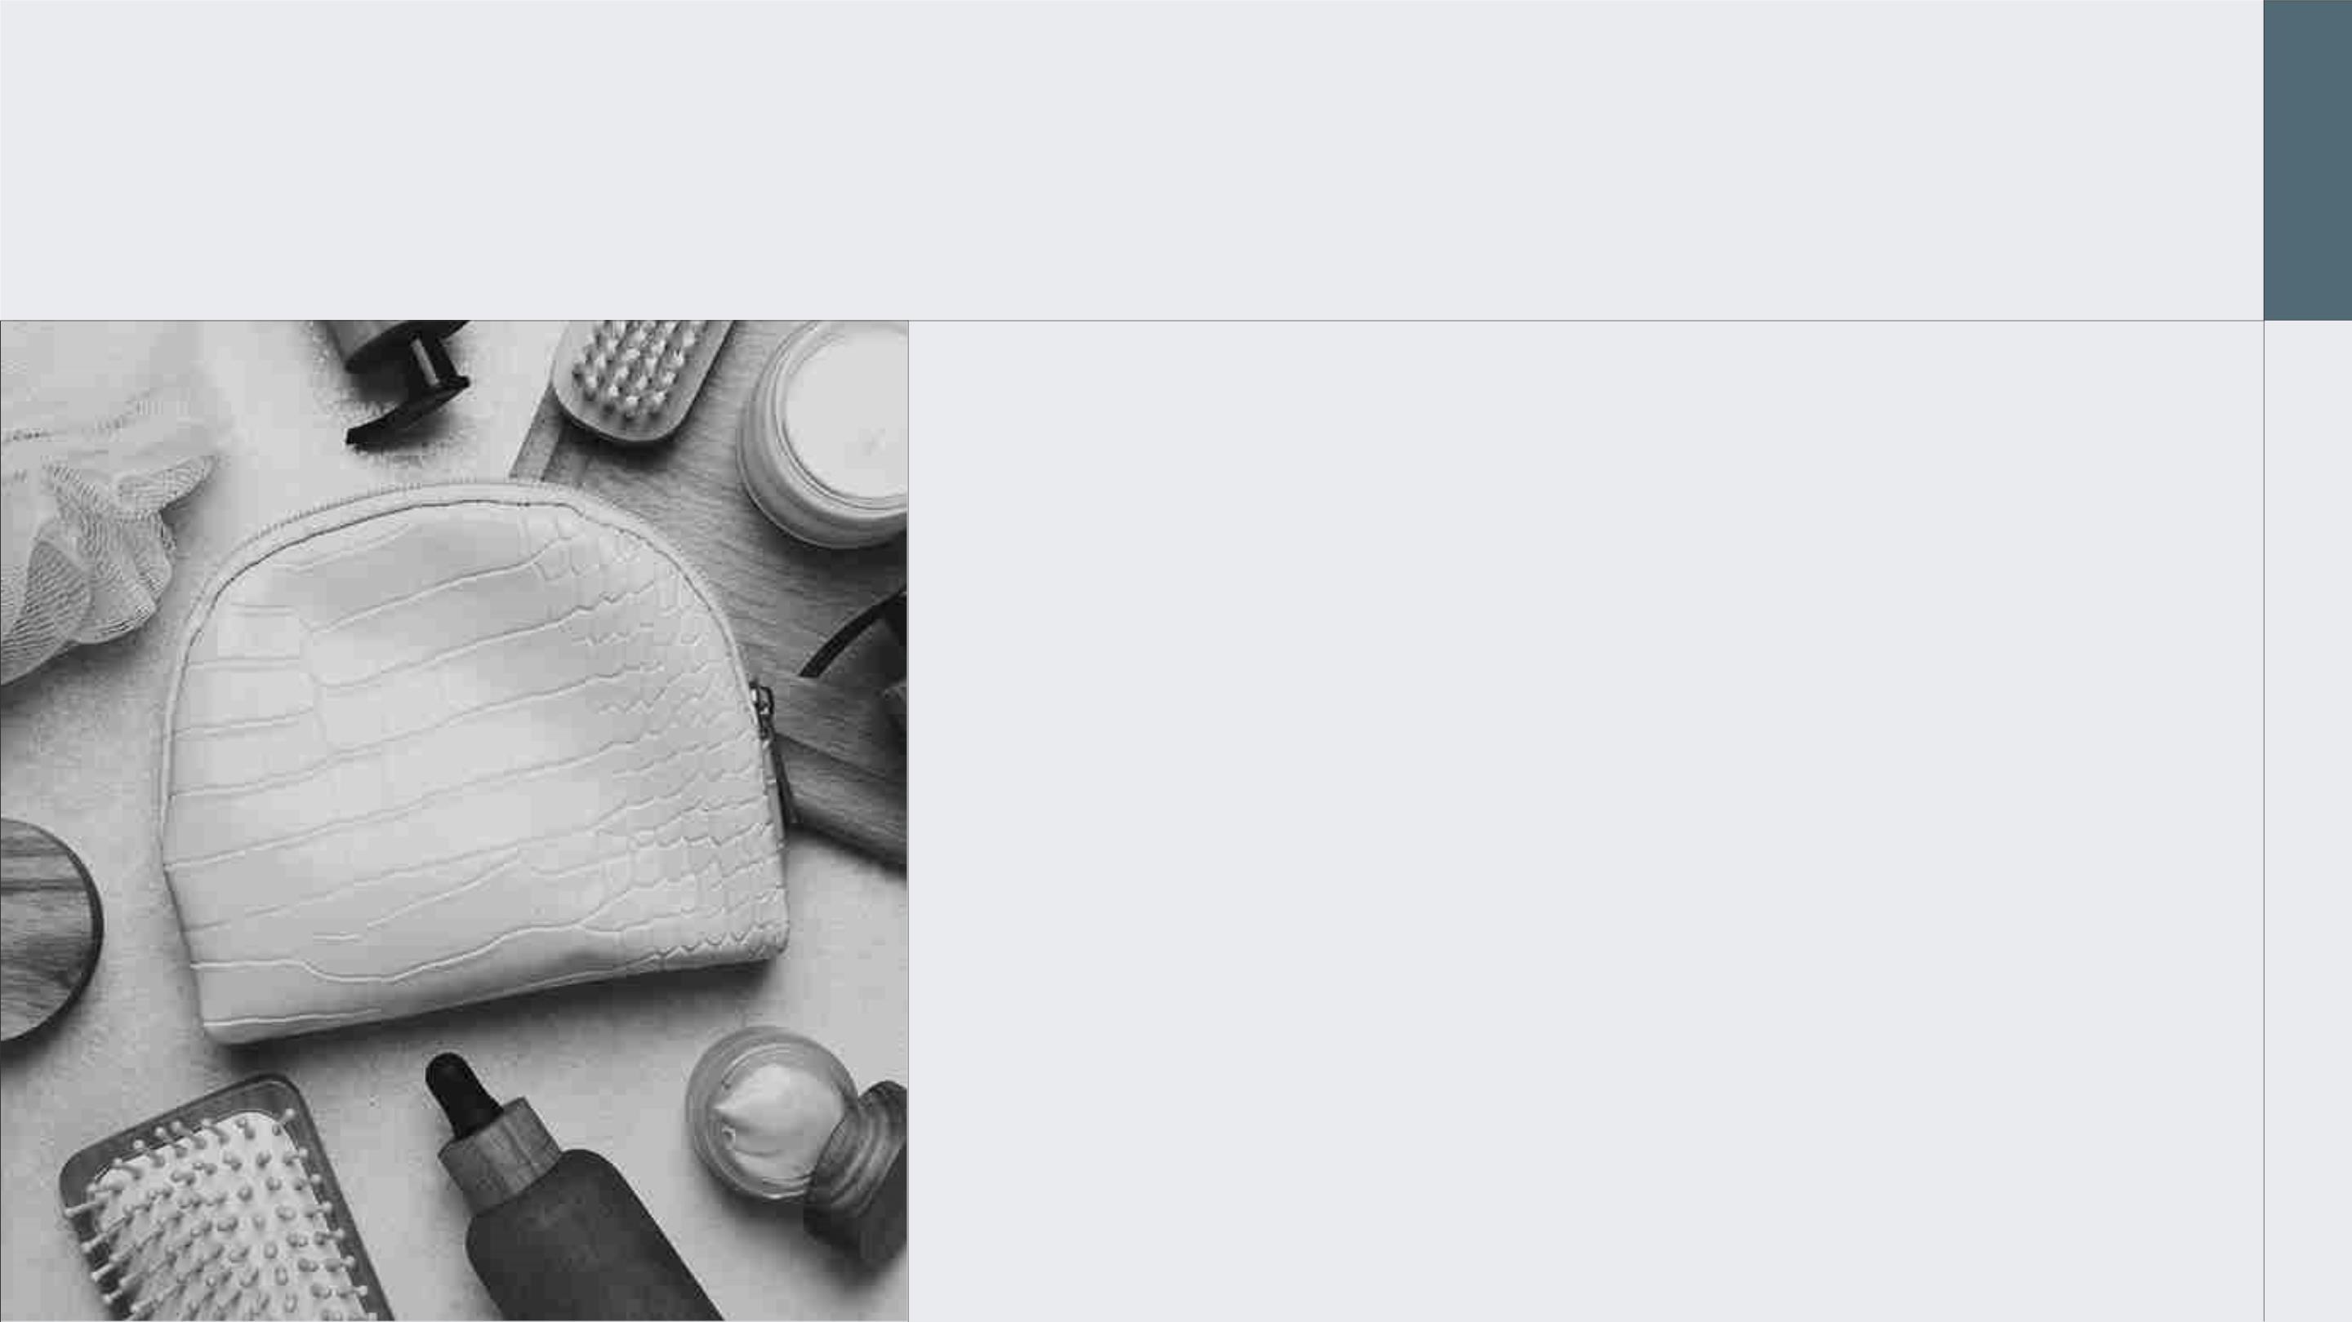
DO YOU NEED A LONGER TEXT?
Mercury’s name has nothing to do with the liquid
metal, since Mercury was named after the Roman
messenger god. Despite being closer to the Sun
than Venus, its temperatures aren't as terribly
hot as that planet's. Its surface is quite similar to
that of Earth's Moon, which means there are a
lot of craters and plains
Mercury takes a little more than 58 days to
complete its rotation, so try to imagine how long
days must be there! Since the temperatures are
so extreme and the solar radiation is so high,
Mercury is non-habitable for humans

Slide 5
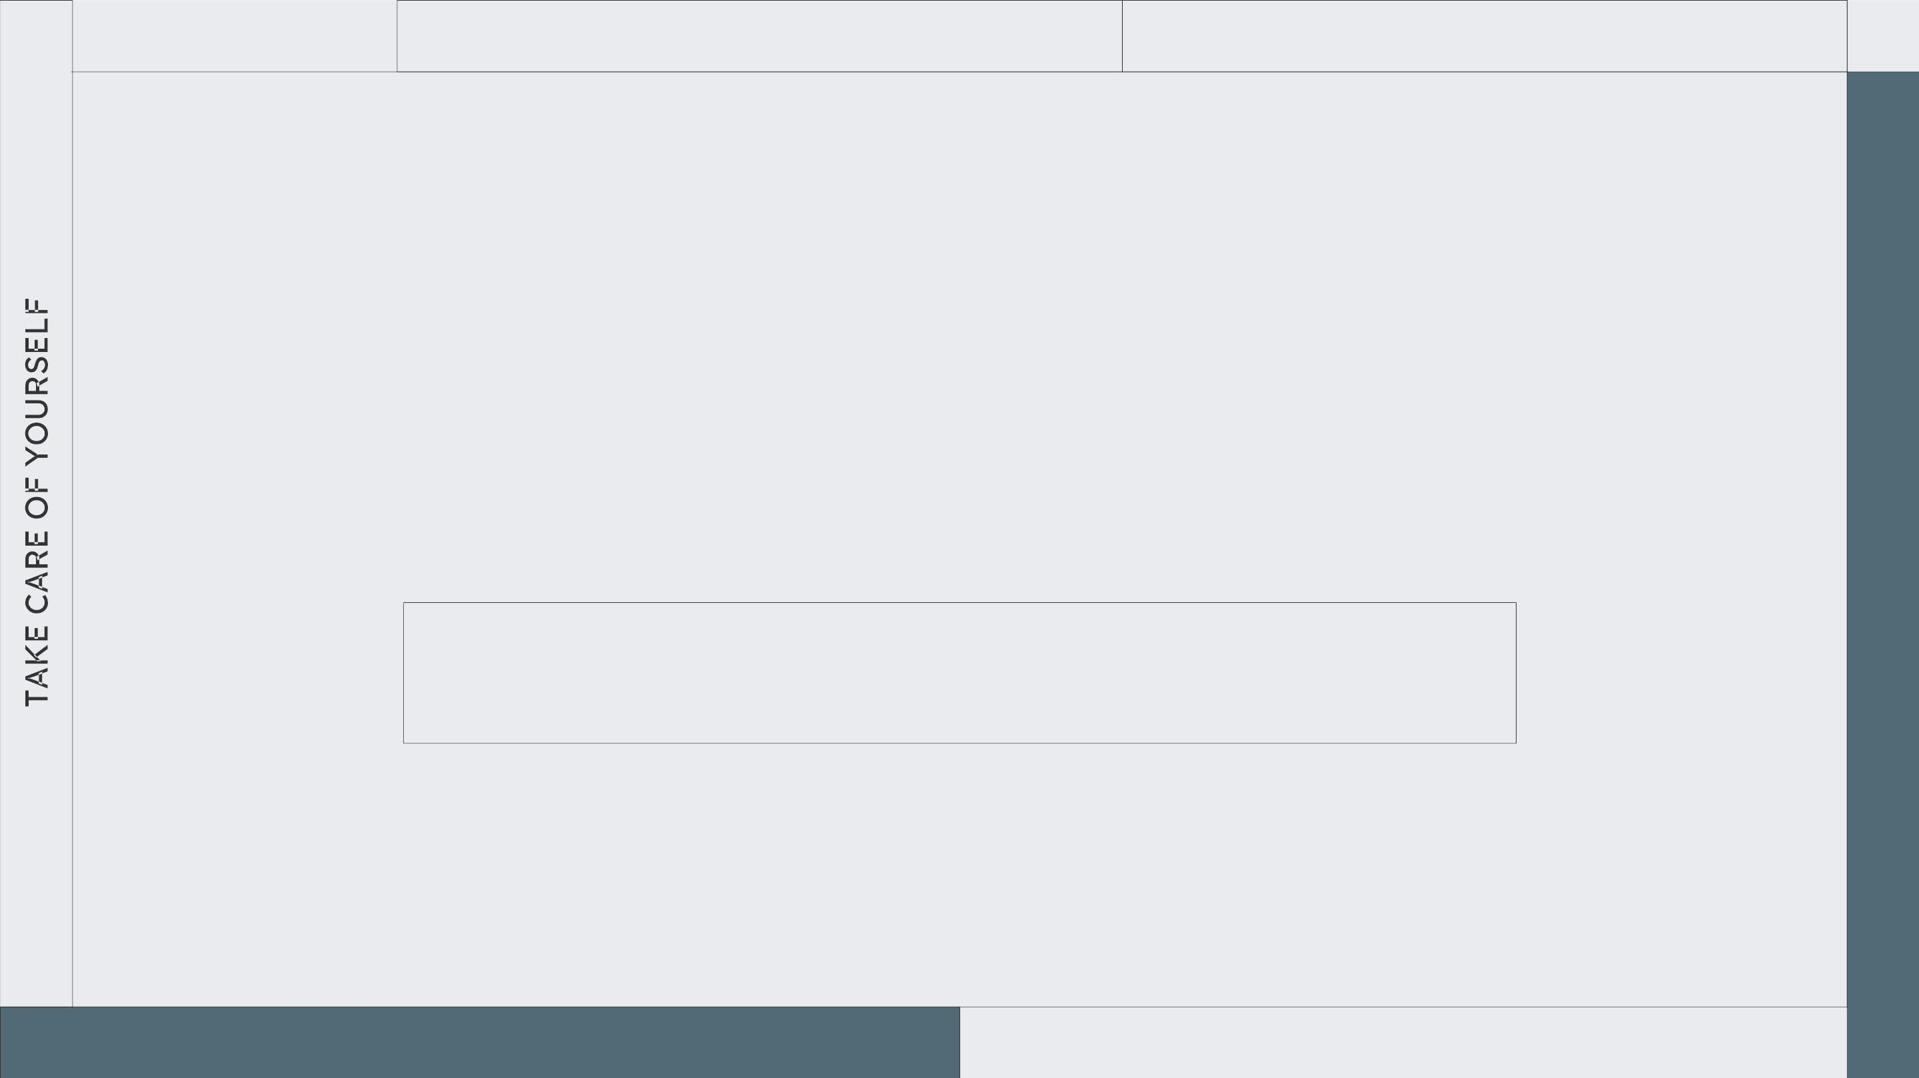
2XXX
CREAMS
WHOA!
This can be the part of the presentation where you
introduce yourself, write your email…

Slide 6
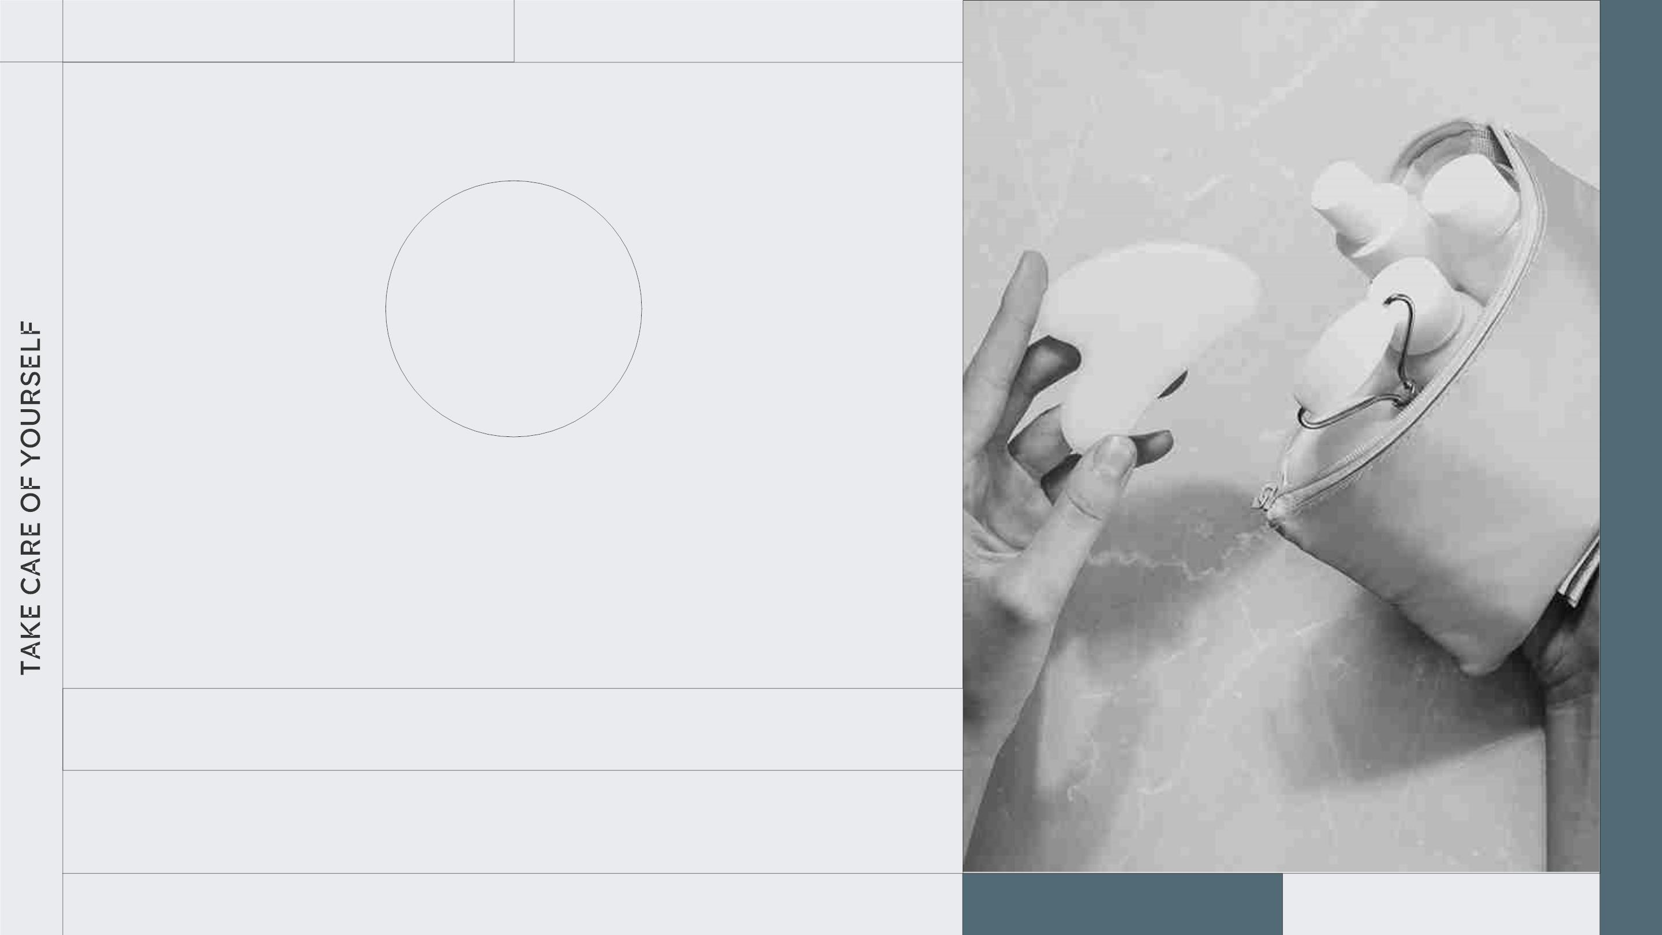
ROUTINE
01
SECTION 1
You can enter a subtitle here if you need it

Slide 7

CHECKLIST
Color the circles depending on whether you have done it or not. This is a good way to
keep track of your routine:
EYES AND FACE
HAIR
Mars is actually a cold place
Saturn has several rings
Venus has a toxic atmosphere
Earth is the planet with life
Ceres is in the asteroid belt
Jupiter is a huge gas giant
The Sun is the closest star to us
Pluto is considered a dwarf planet
Neptune is very far away from us
Mercury is a small planet

Slide 8
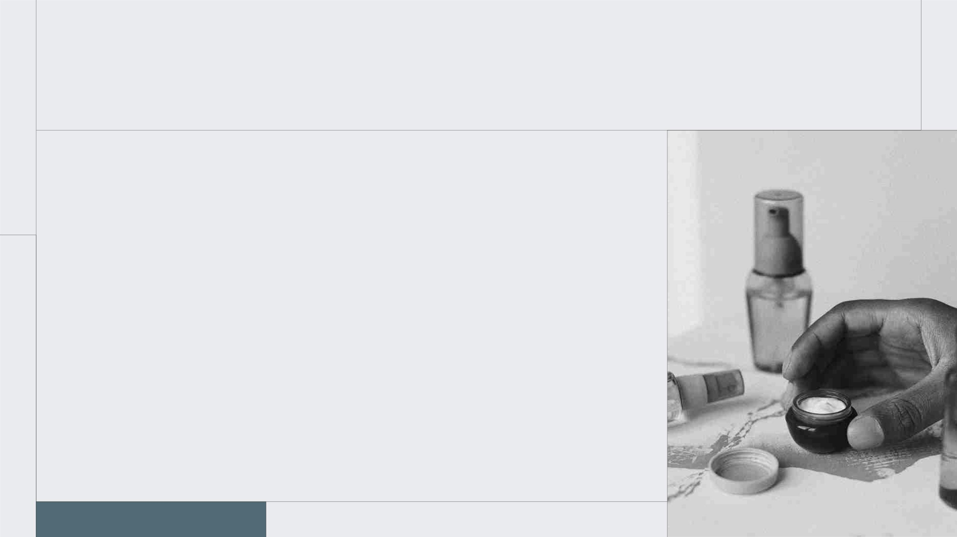
THE SLIDE TITLE GOES HERE!
Do you know what helps you make your point crystal
clear? Lists like this one:
● They’re simple
● You can organize your ideas clearly
● You’ll never forget to buy milk!
And the most important thing: the audience won’t
miss the point of your presentation

Slide 9
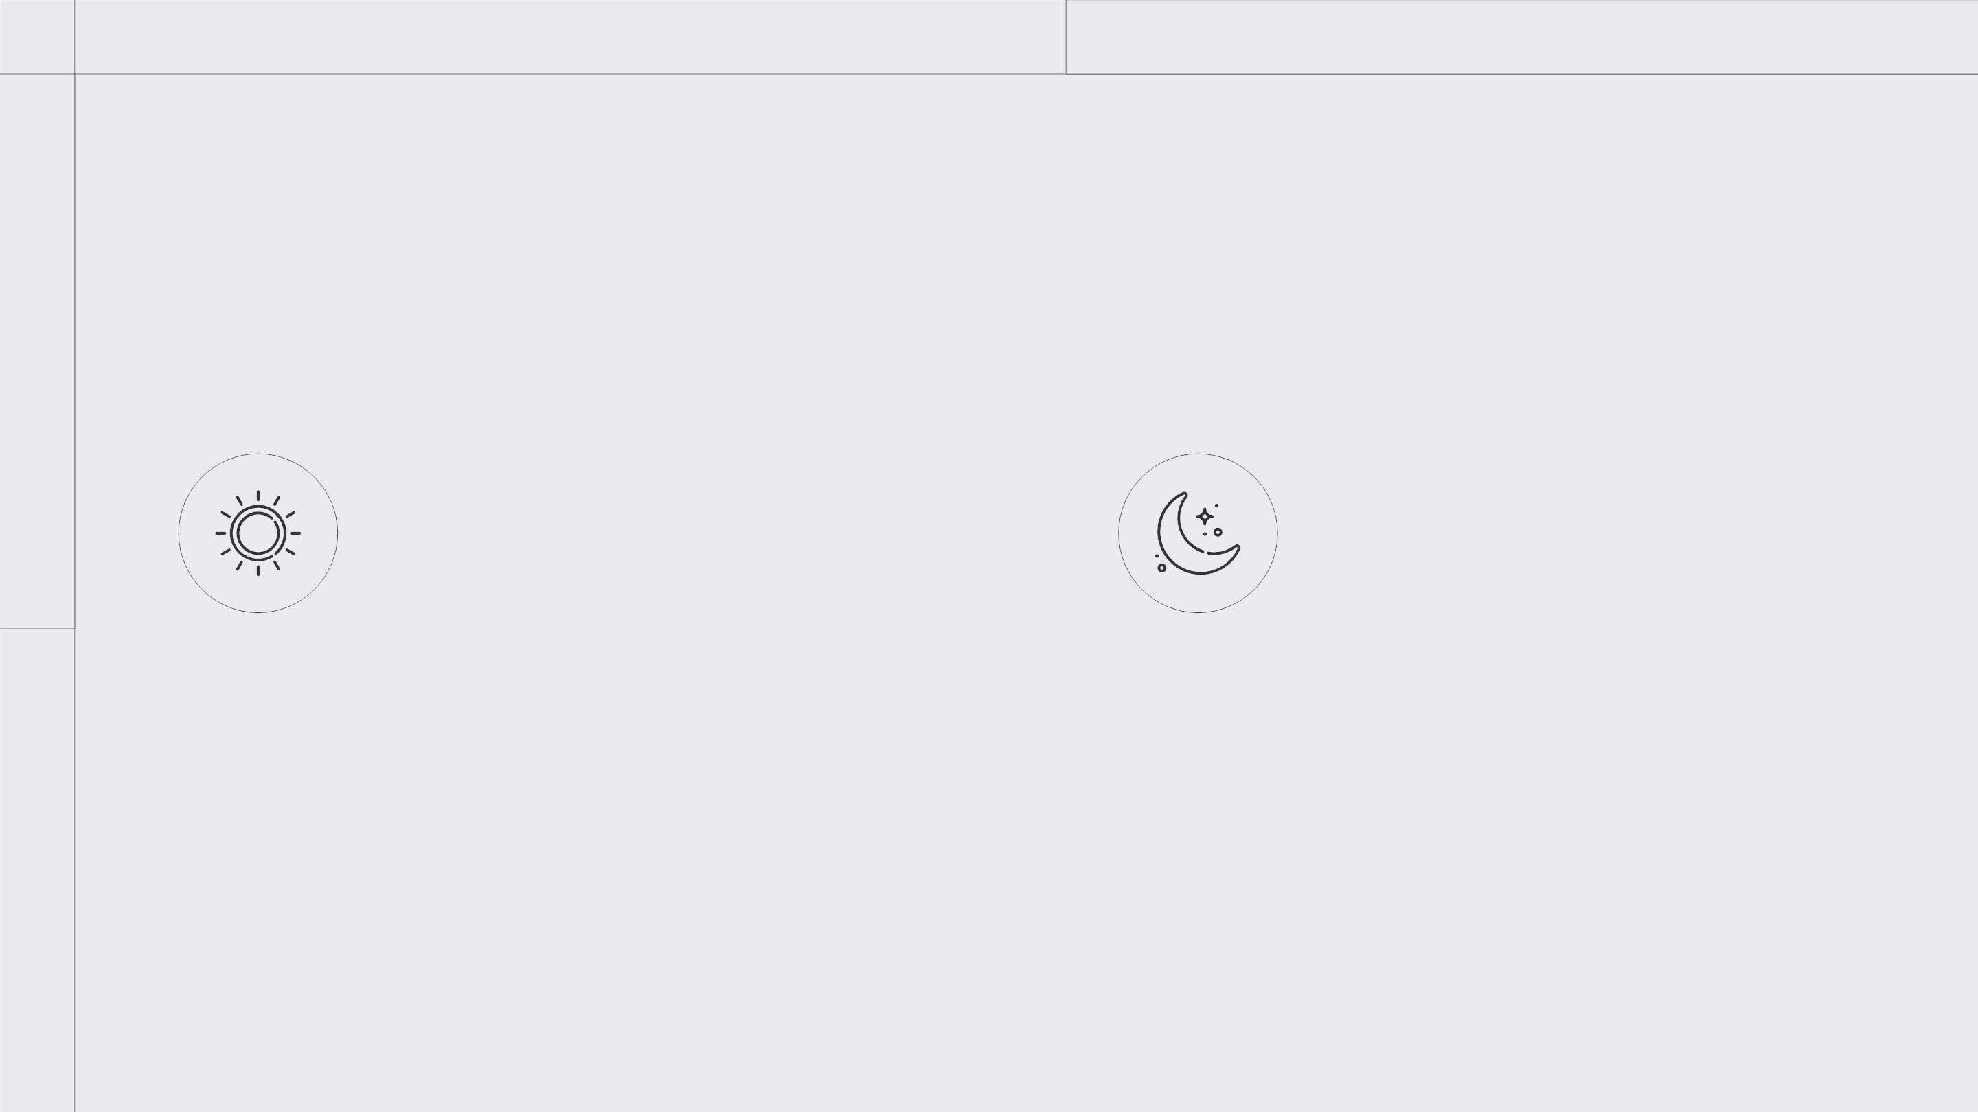
MAYBE YOU NEED TO DIVIDE
THE CONTENT
MERCURY
VENUS
Mercury is the closest planet to
the Sun and the smallest one in
the Solar System—it’s only a bit
larger than the Moon
Venus has a beautiful name and is
the second planet from the Sun.
It’s hot and has an extremely
poisonous atmosphere

Slide 10
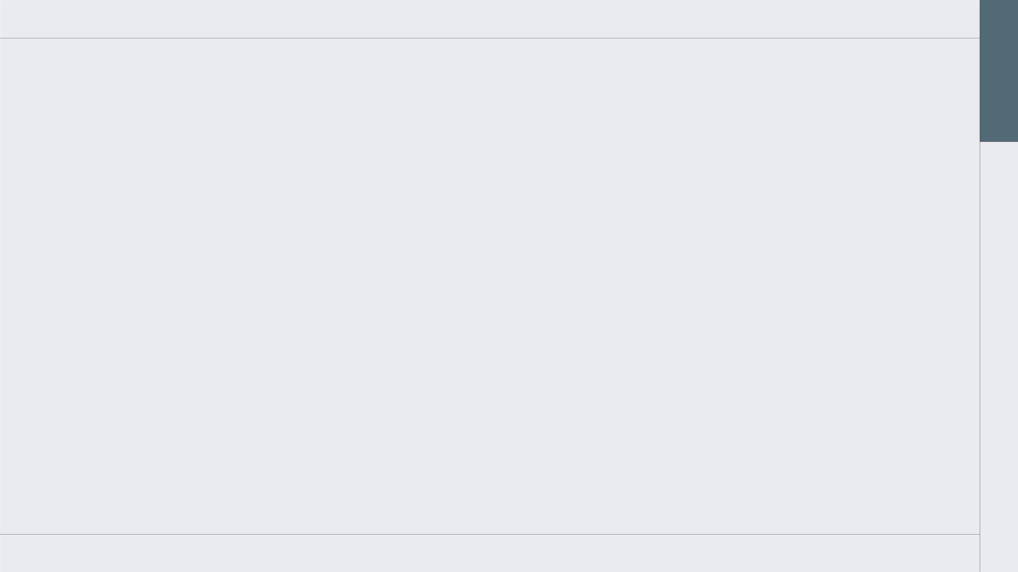
TRY DEFINING FIVE CONCEPTS
EARTH
MERCURY
VENUS
Earth is the only planet
that harbors life in the
Solar System
Mercury is the closest
planet to the Sun and
the smallest one
Venus has a beautiful
name and is the second
planet from the Sun
MARS
JUPITER
Despite being red, Mars
is a cold place. It's full of the biggest planet in the
iron oxide dust Solar System
Jupiter is a gas giant and

Slide 11
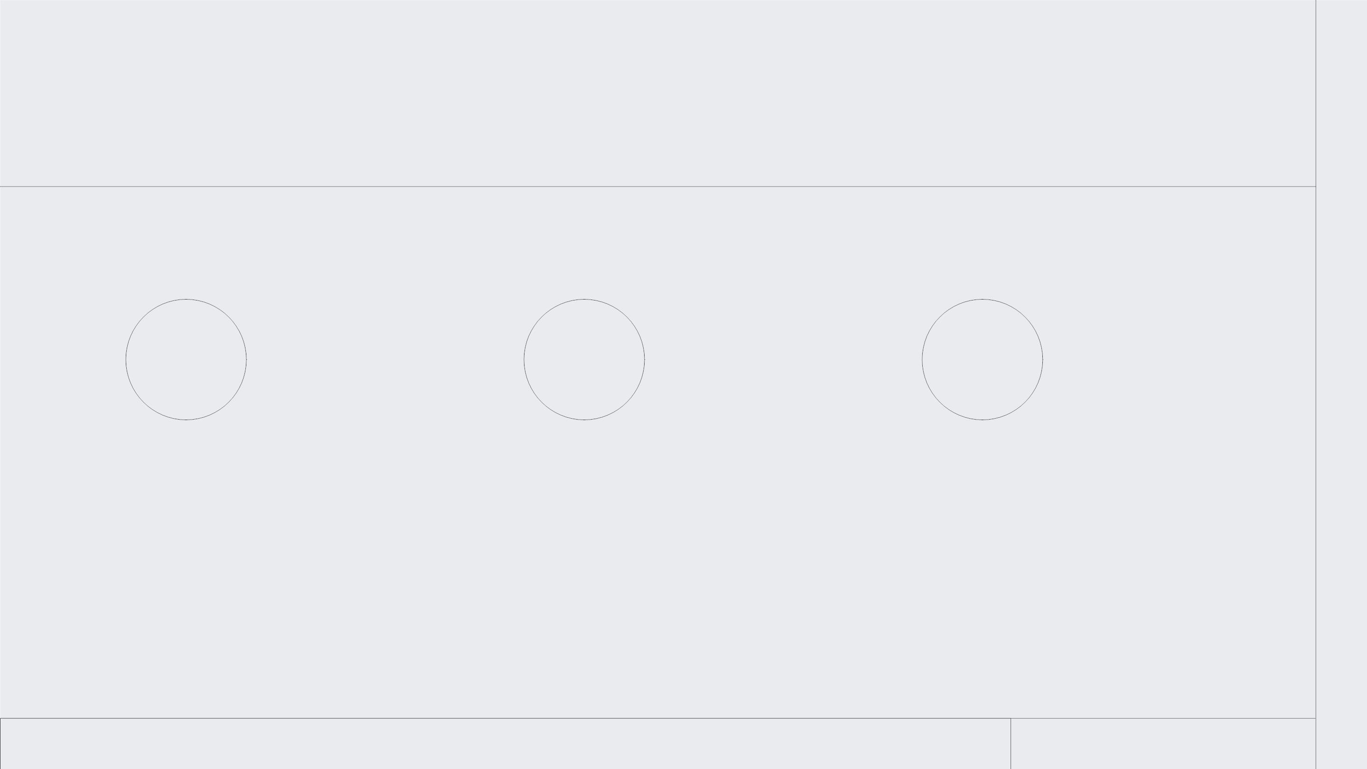
THREE IMPORTANT IDEAS
01 02 03
MERCURY
VENUS
MARS
Mercury is the closest
planet to the Sun and
the smallest one
Venus has a beautiful
name and is the second
planet from the Sun
Despite being red, Mars
is actually a cold place.
It’s full of iron oxide dust

Slide 12
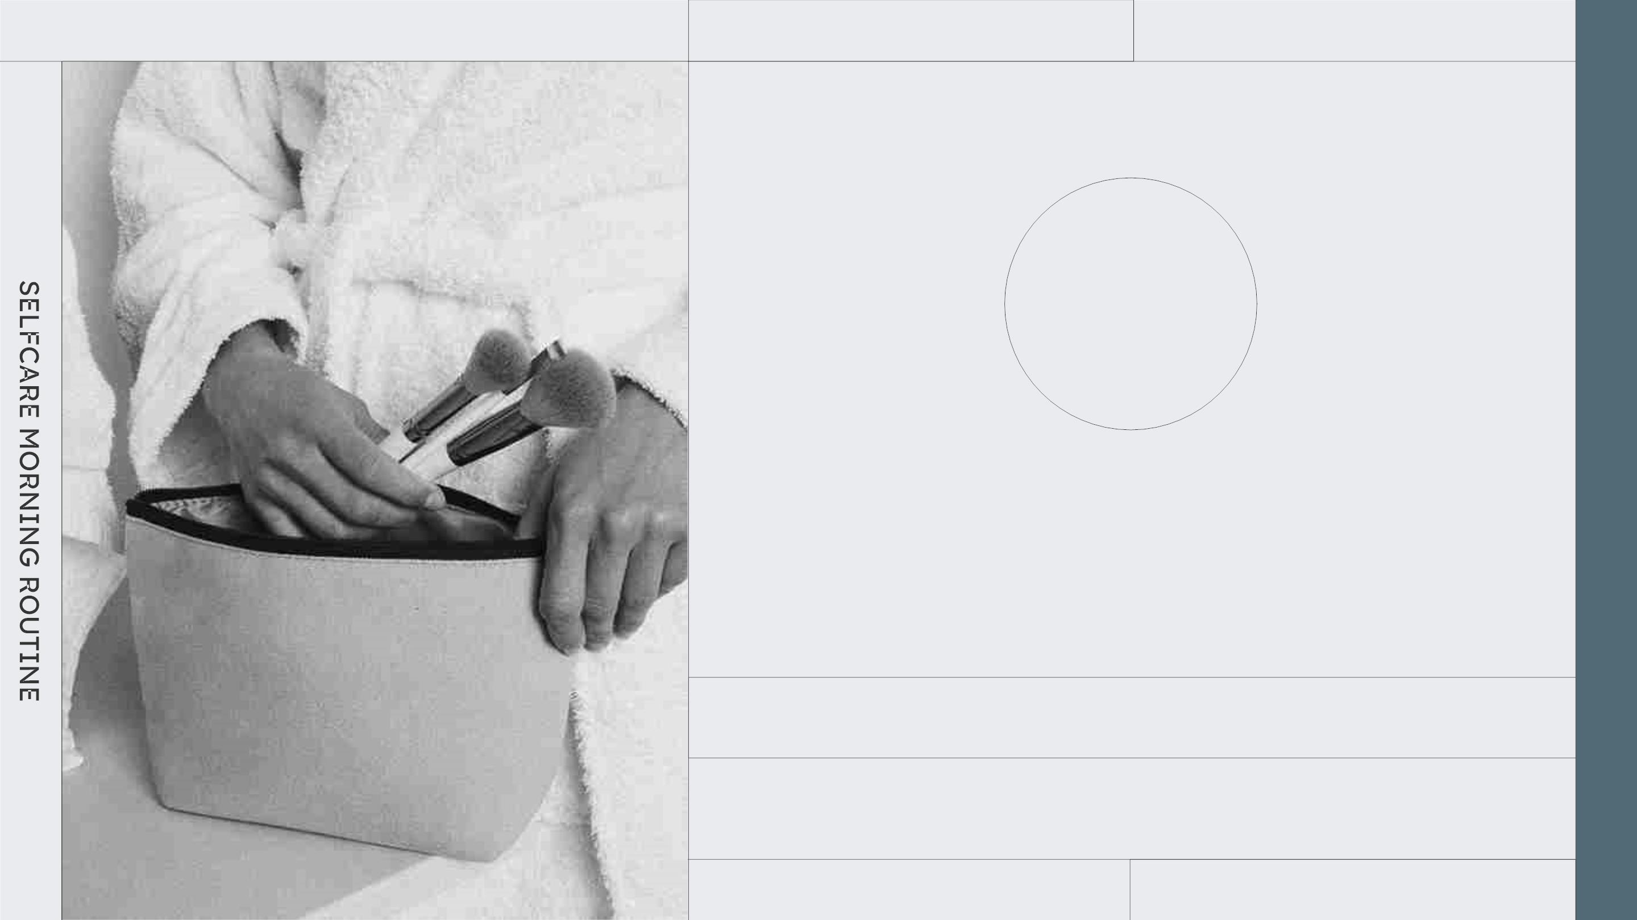
2XXX
02
SECTION 2
You can enter a subtitle here if you need it
MAKE UP

Slide 13
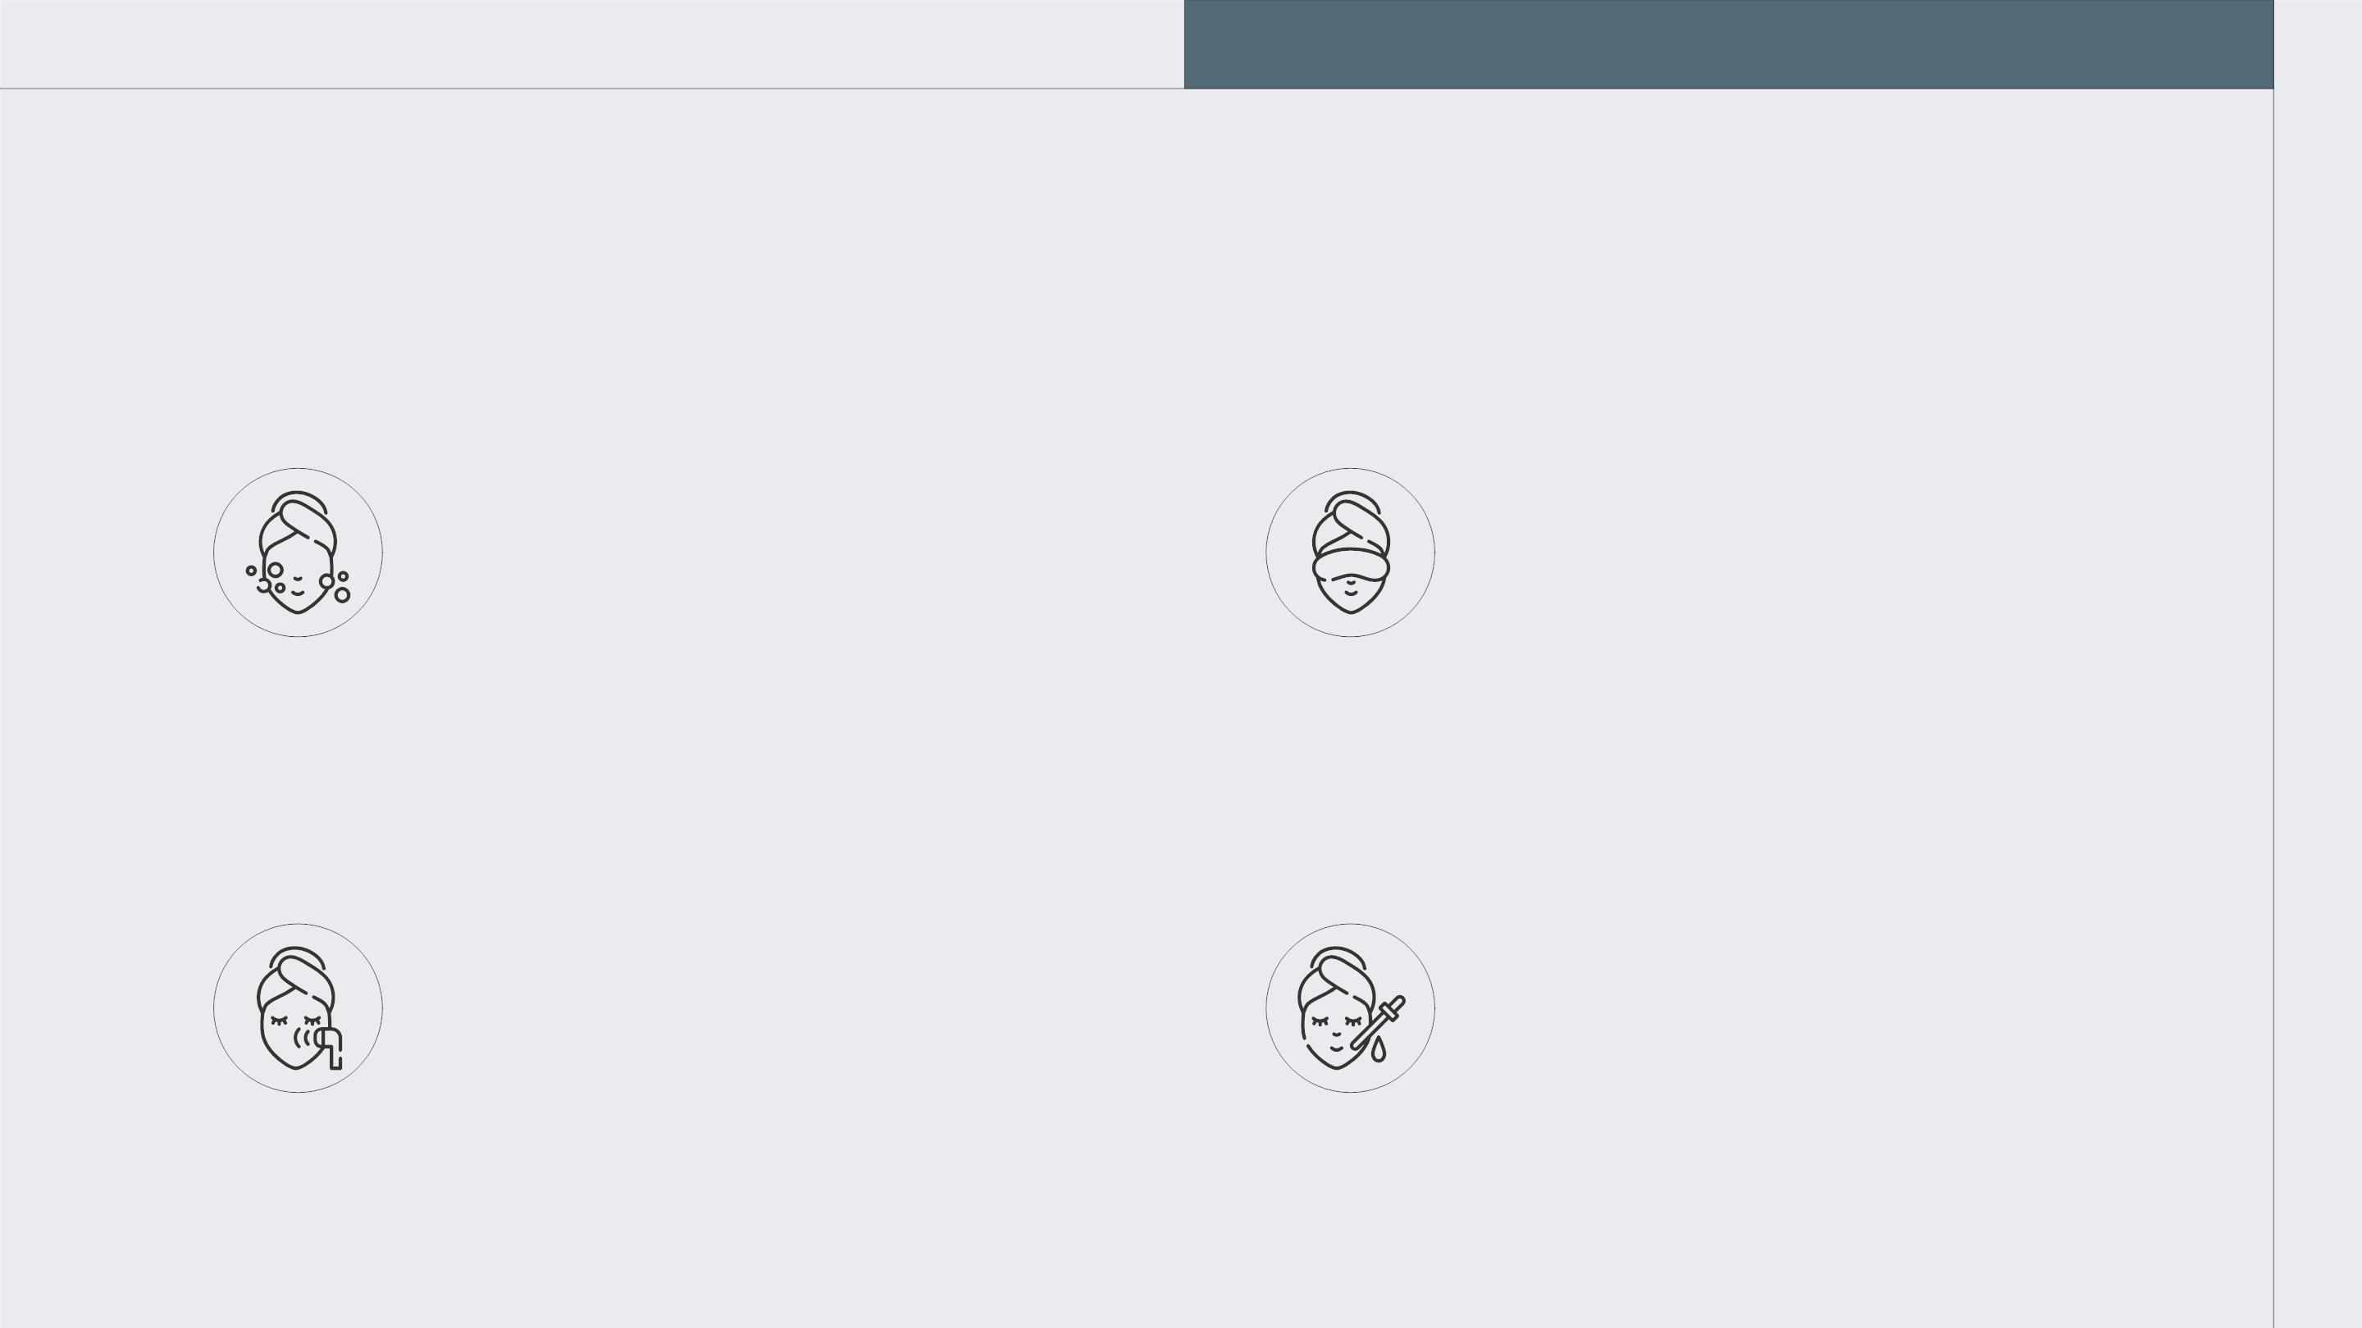
THESE ARE FOUR ALTERNATIVES
MARS
JUPITER
Despite being red, Mars is
actually a cold place. It's full
of iron oxide dust
Jupiter is a gas giant and the
biggest planet in the entire
Solar System
SATURN
EARTH
Saturn is a gas giant and hsa
rings. It's composed mostly
of hydrogen and helium
Earth is the third planet from
the Sun and the only one
that harbors life

Slide 14
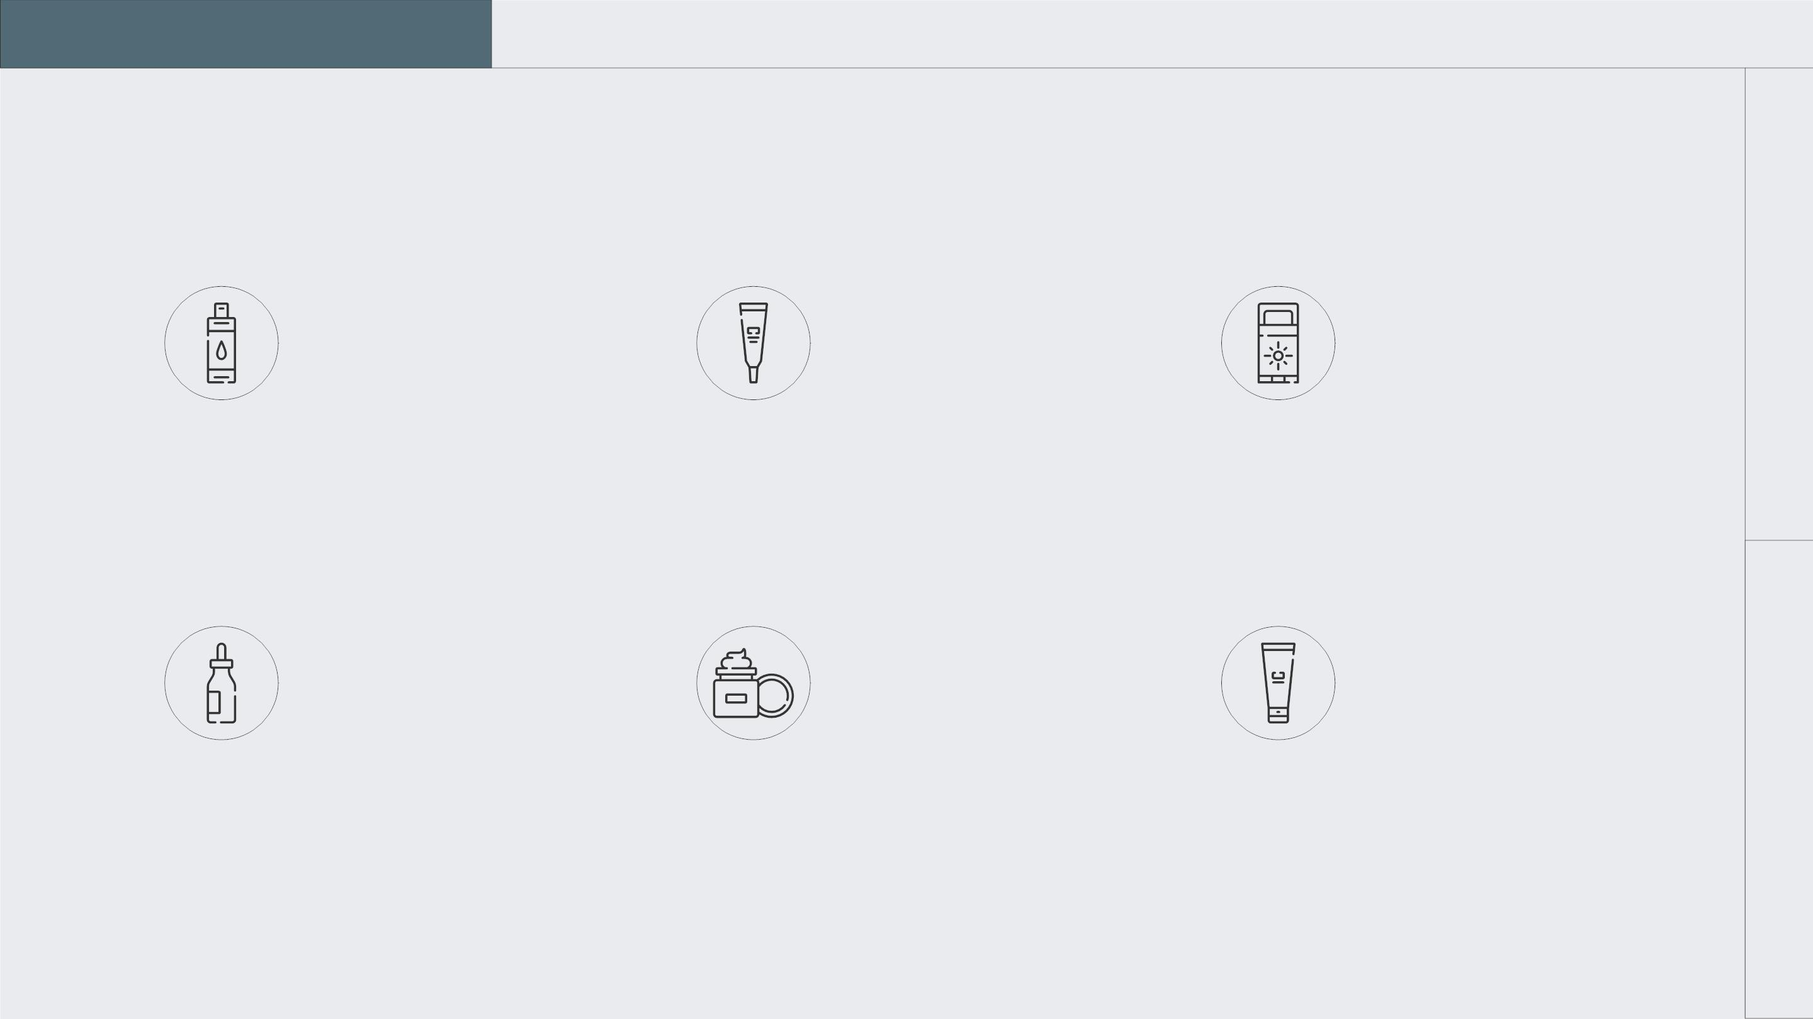
DIFFERENT PRODUCTS
MARS
Despite being red, Mars
is actually a cold place
MERCURY
Mercury is the closest
planet to the Sun
SATURN
Saturn is a gas giant
with several rings
NEPTUNE
Neptune is the farthest
planet from the Sun
JUPITER
Jupiter is the biggest
planet of them all
VENUS
Venus is the second
planet from the Sun

Slide 15
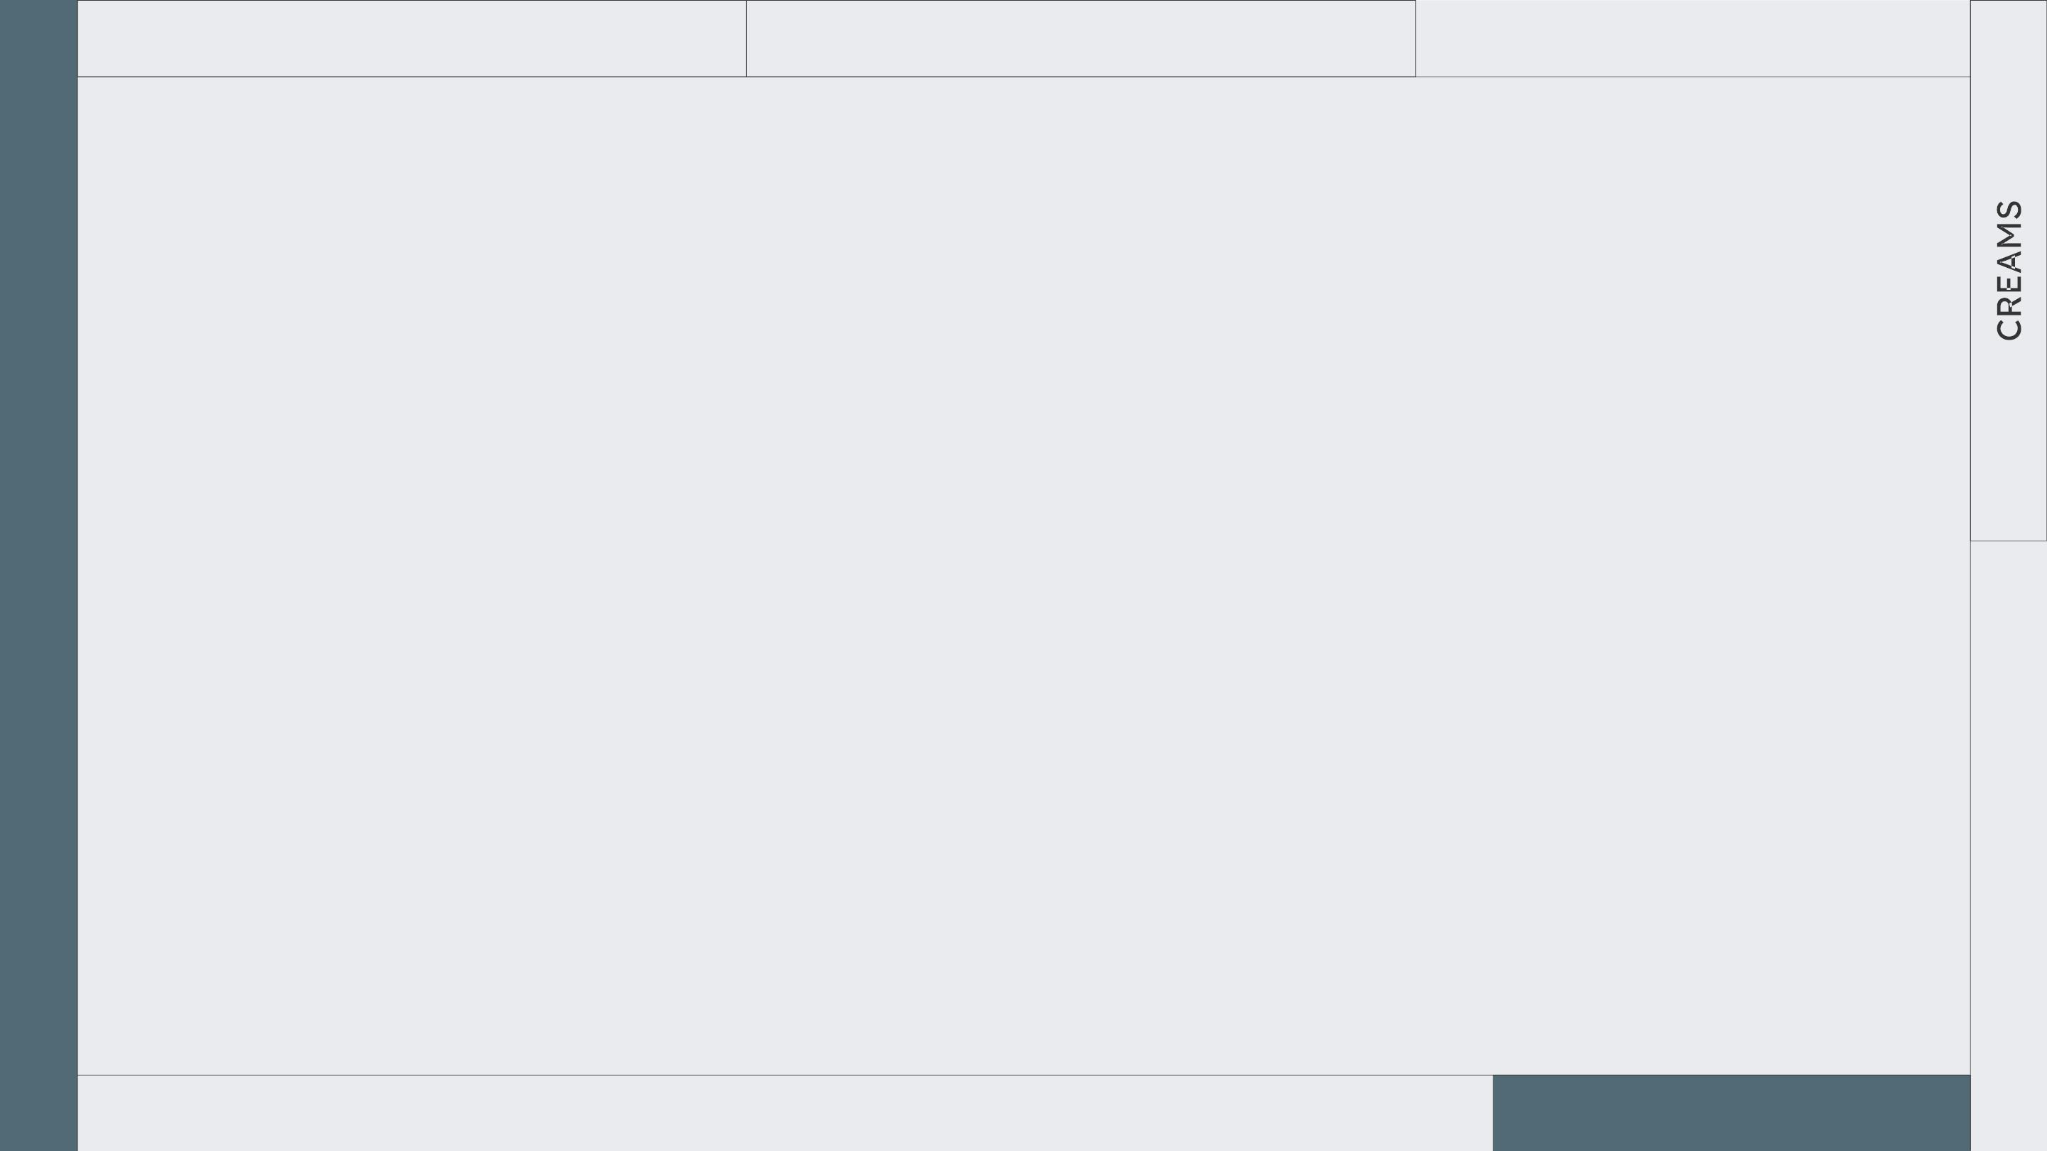
TAKE CARE OF YOURSELF
MORNINGS
AWESOME
WORDS

Slide 16
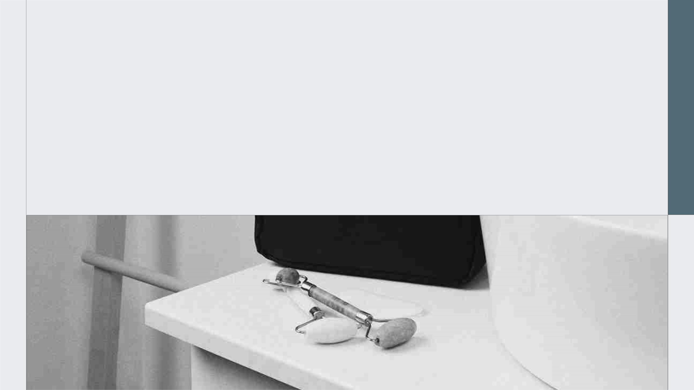
“This is a quote, words full of wisdom
that someone important said and can
make the reader get inspired.”
—SOMEONE FAMOUS

Slide 17
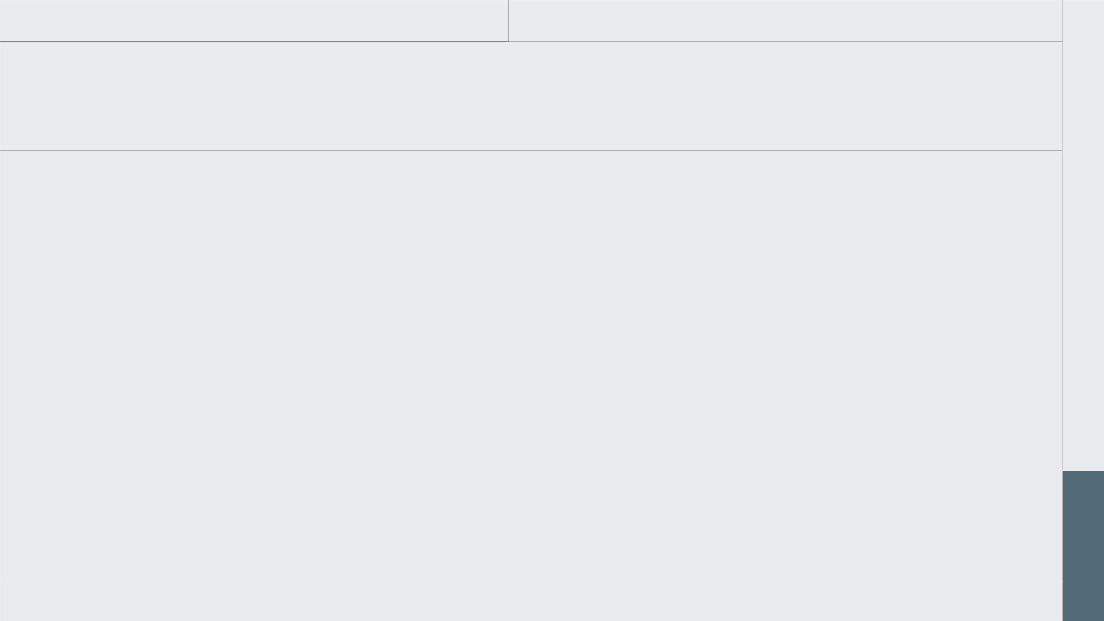
IMPORTANT CONCEPTS
SATURN
It’s composed of hydrogen and helium
JUPITER
Jupiter doesn’t have a solid surface
MARS
Despite being red, Mars is very cold
NEPTUNE
Neptune is far away from us
EARTH
Earth is the third planet from the Sun
CERES
It’s located in the main asteroid belt
VENUS
It’s the second planet from the Sun
PLUTO
Pluto is considered a dwarf planet

Slide 18
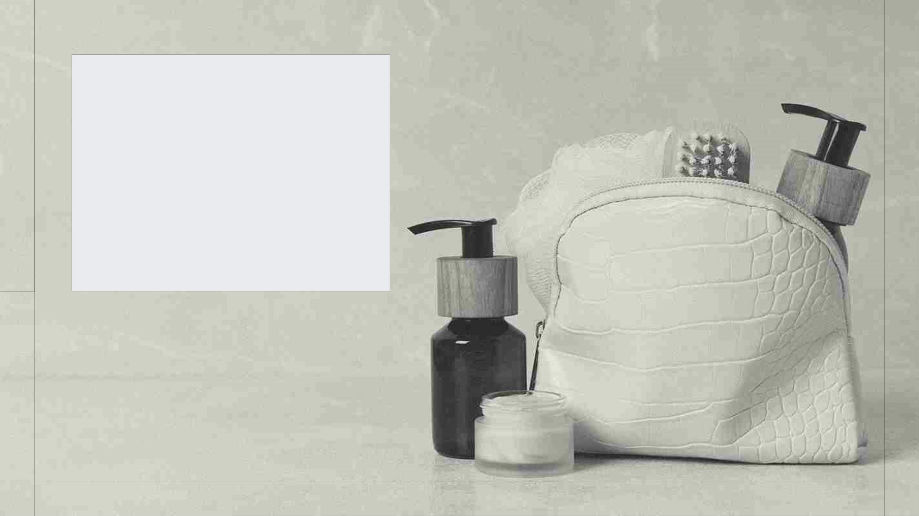
A PICTURE
IS WORTH A
THOUSAND
WORDS

Slide 19
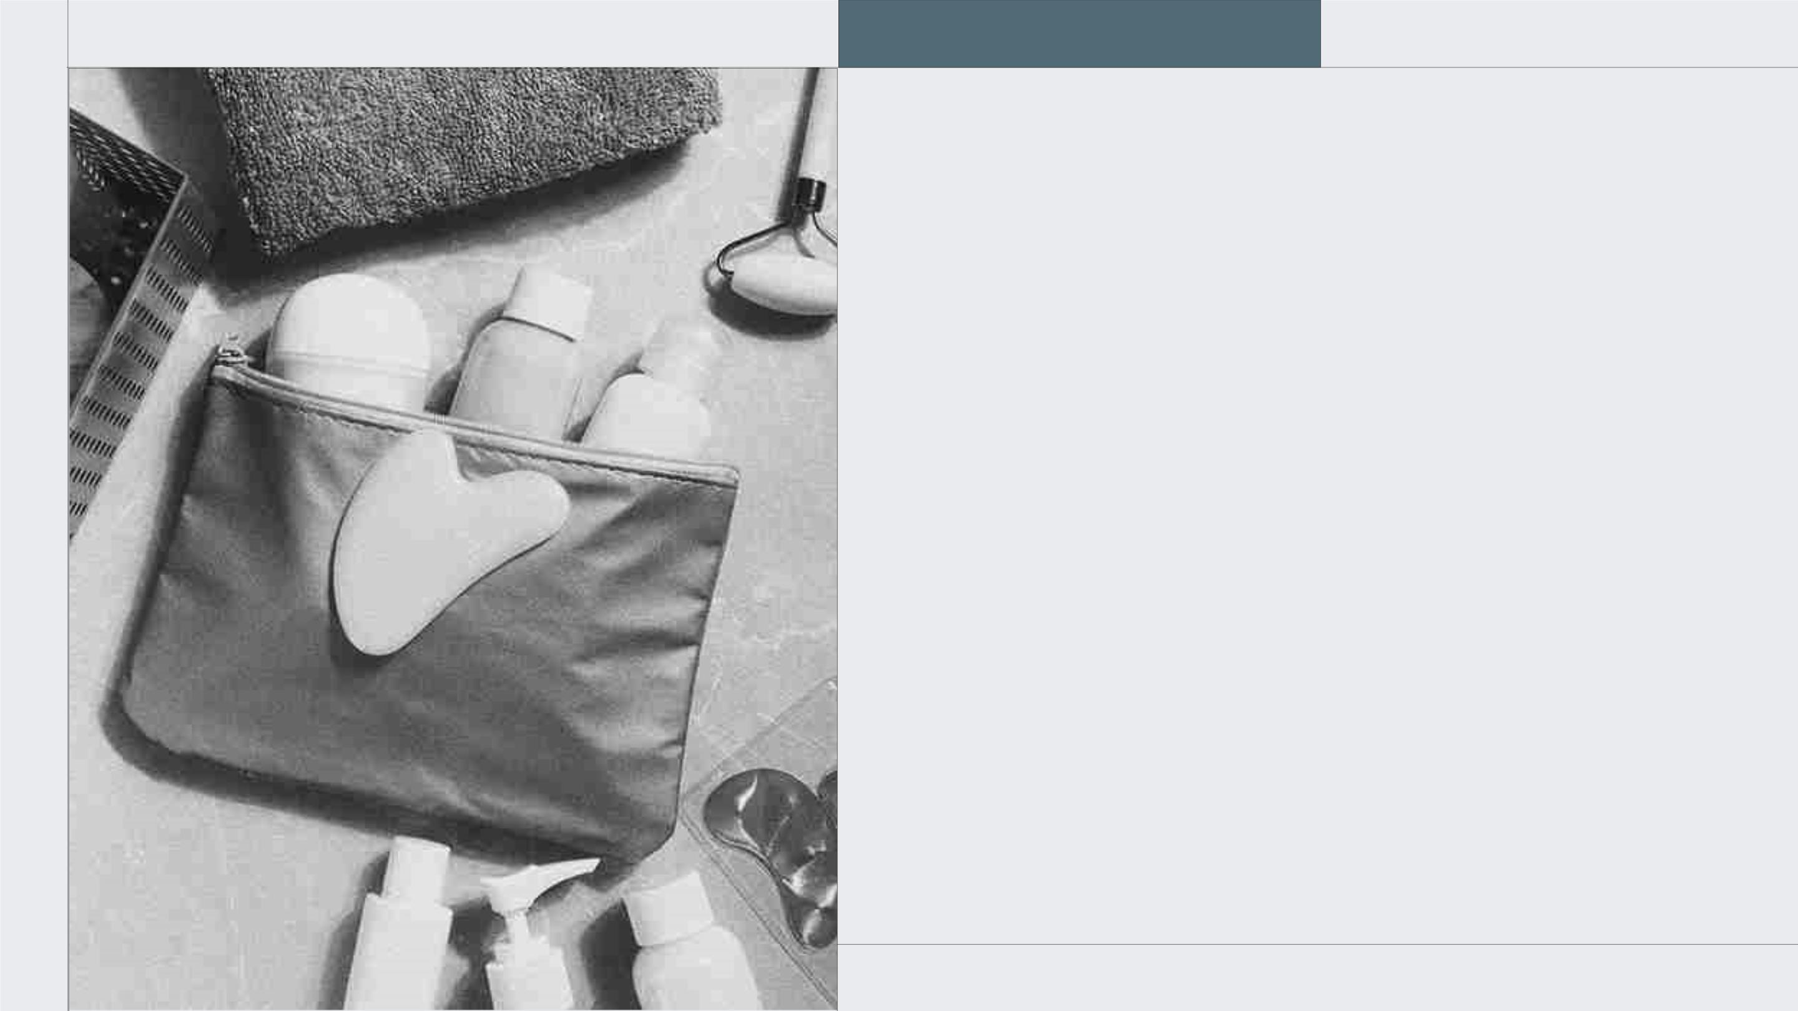
A PICTURE
ALWAYS
REINFORCES
THE CONCEPT
Images reveal large amounts of data,
so remember: use an image instead of
a long text. Your audience will
appreciate it for sure

Slide 20
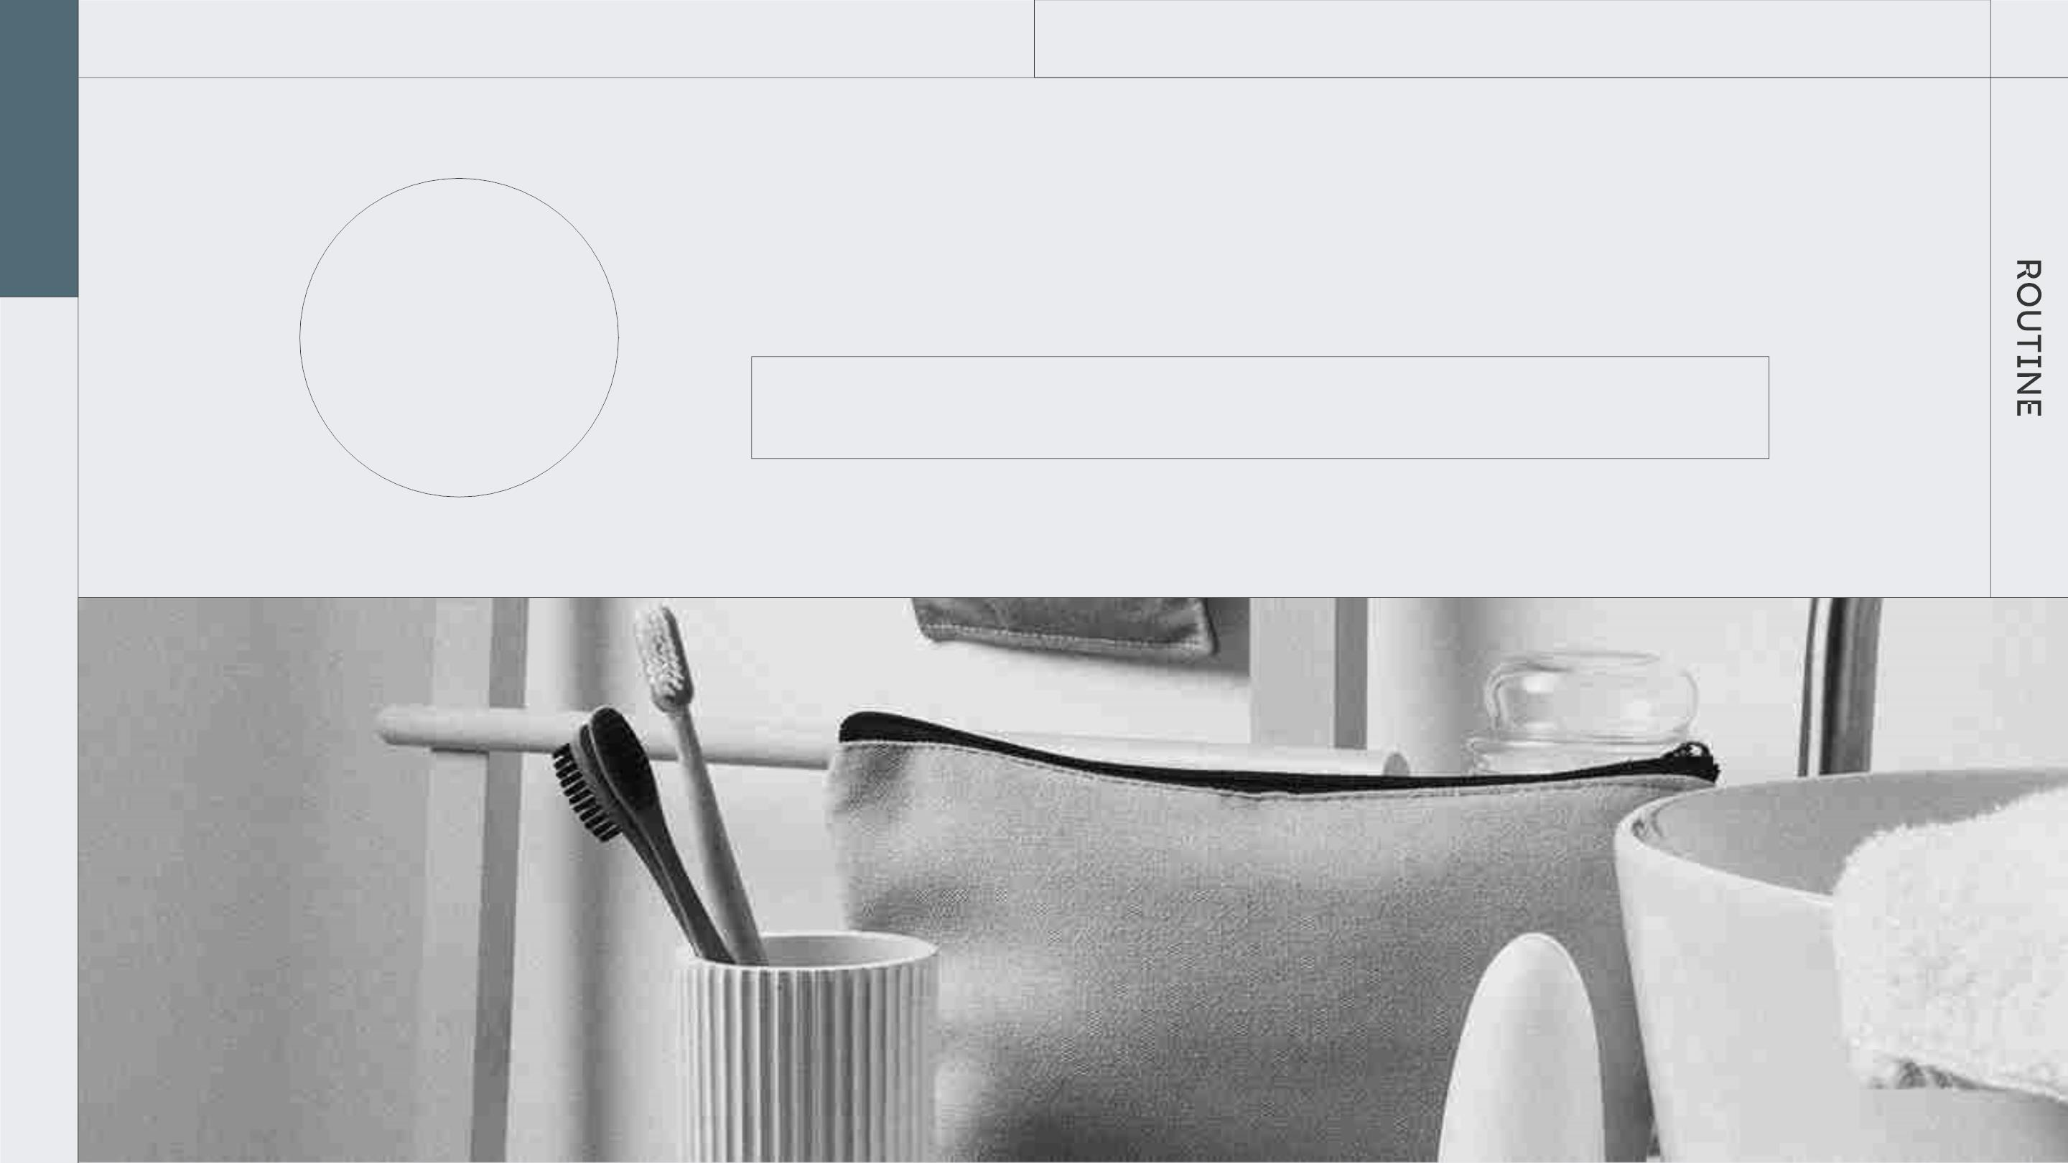
TAKE CARE OF YOURSELF
SECTION 3
03
You can enter a subtitle here if you need it

Slide 21
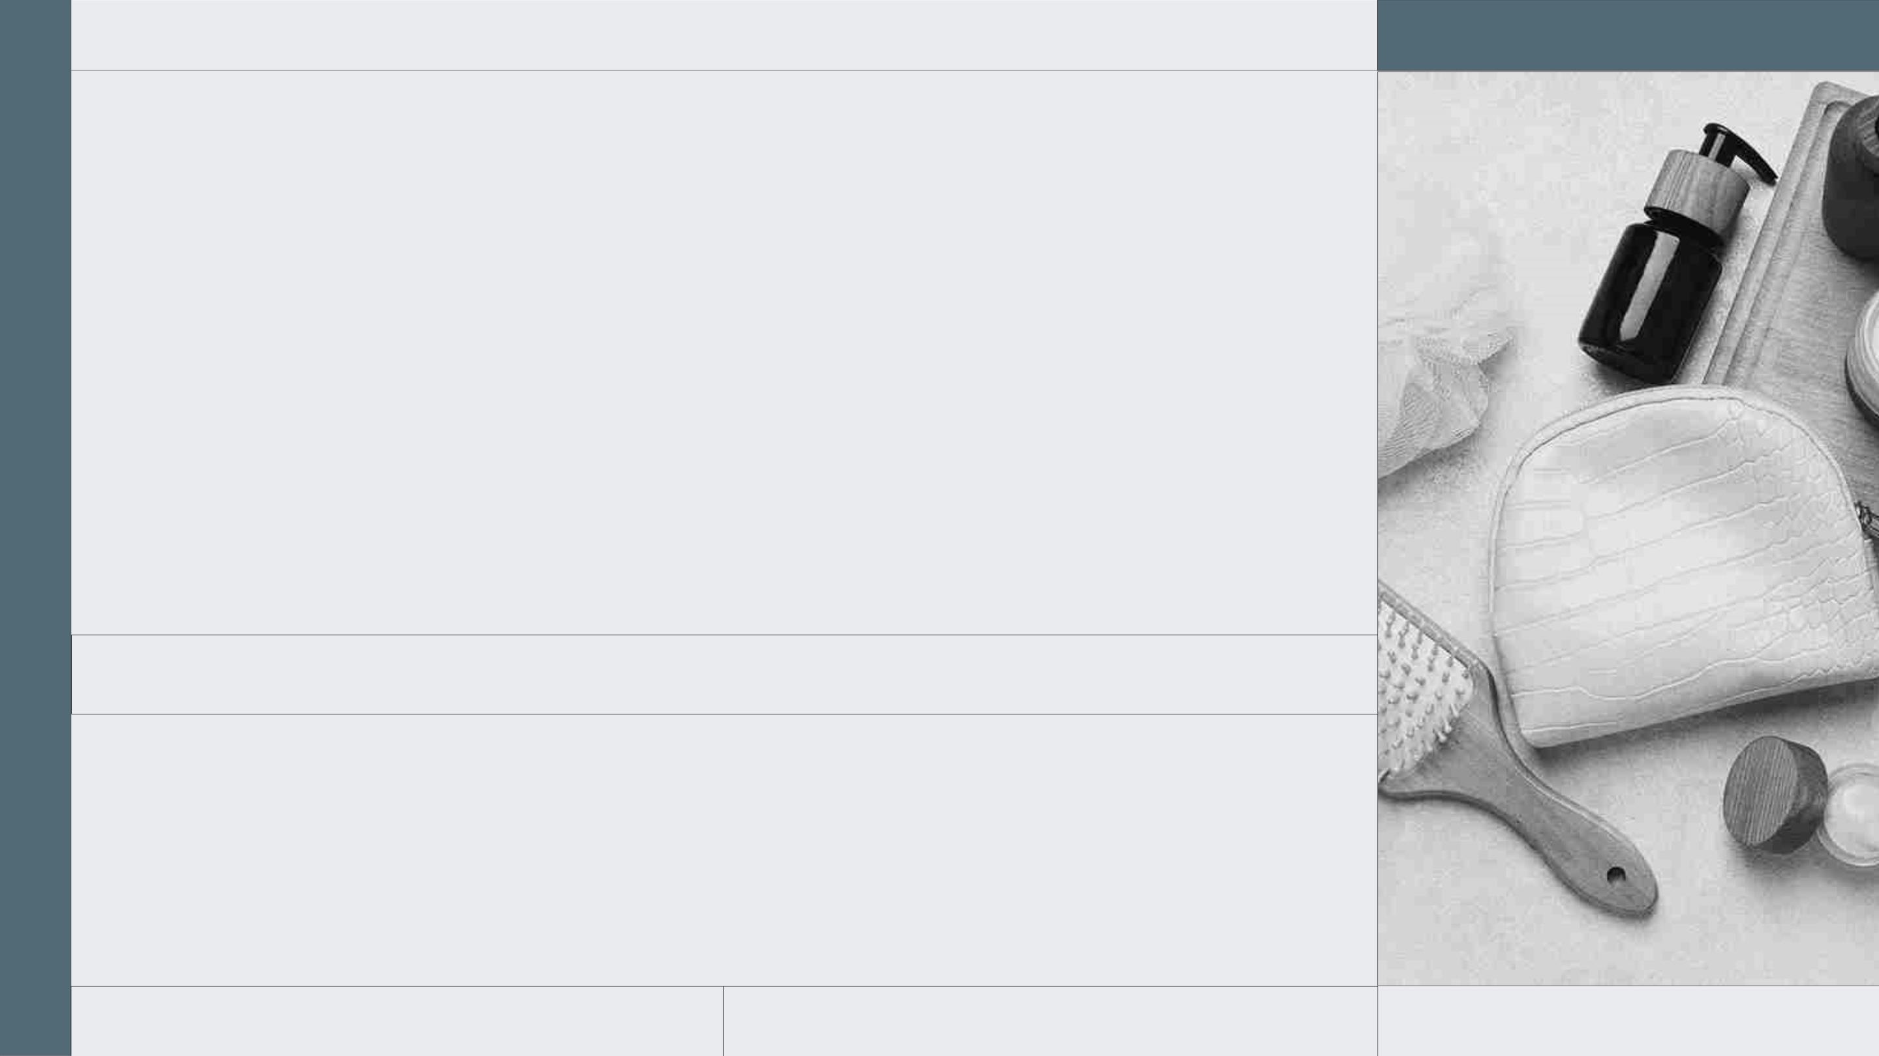
4,498,300
Big numbers catch your audience’s attention
SELFCARE
2XXX

Slide 22
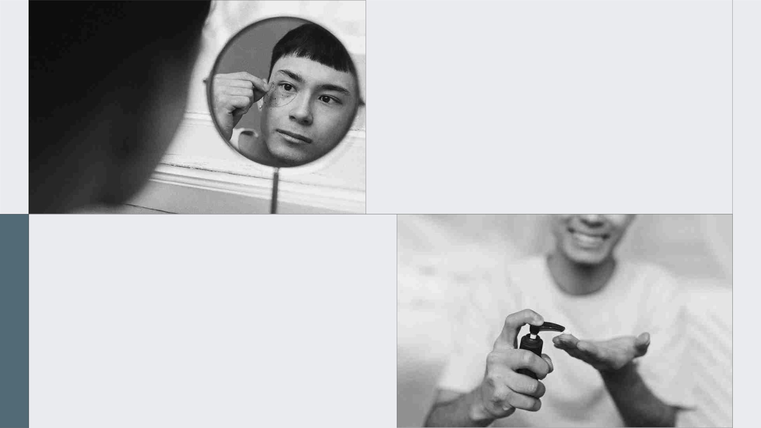
333,000
The Sun’s mass compared to Earth’s
9h 55m 23s
Jupiter's rotation period

Slide 23
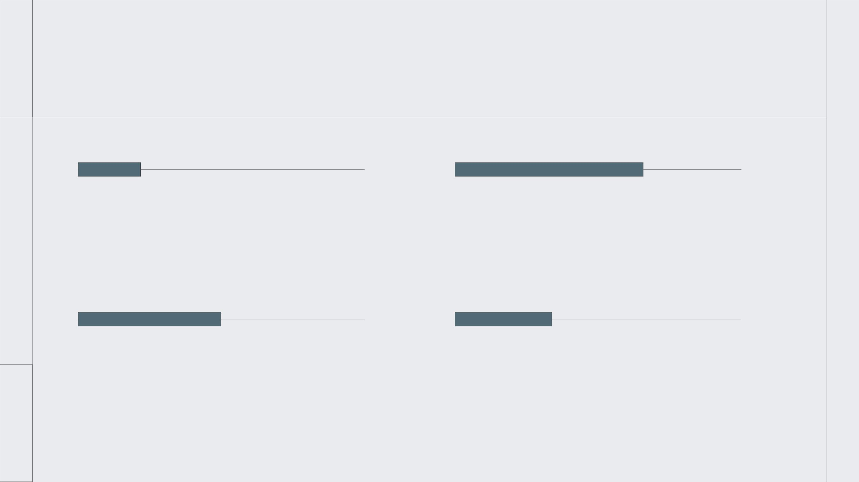
LET’S USE SOME PERCENTAGES…
20%
Mercury is the closest planet to the
60%
Jupiter is a gas giant and the
Sun and the smallest one
biggest planet in the Solar System
50%
Despite being red, Mars is actually
30%
Saturn was named after the Roman
a very cold place
god of wealth and agriculture

Slide 24
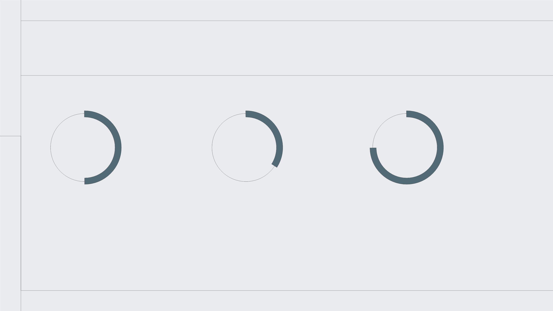
… OR MAYBE LIKE THIS?
50% 30% 75%
MERCURY
MARS
JUPITER
Mercury is the closest
planet to the Sun and
the smallest of them all iron oxide dust
Despite being red, Mars
is a cold place. It's full of the biggest planet in the
Jupiter is a gas giant and
Solar System

Slide 25
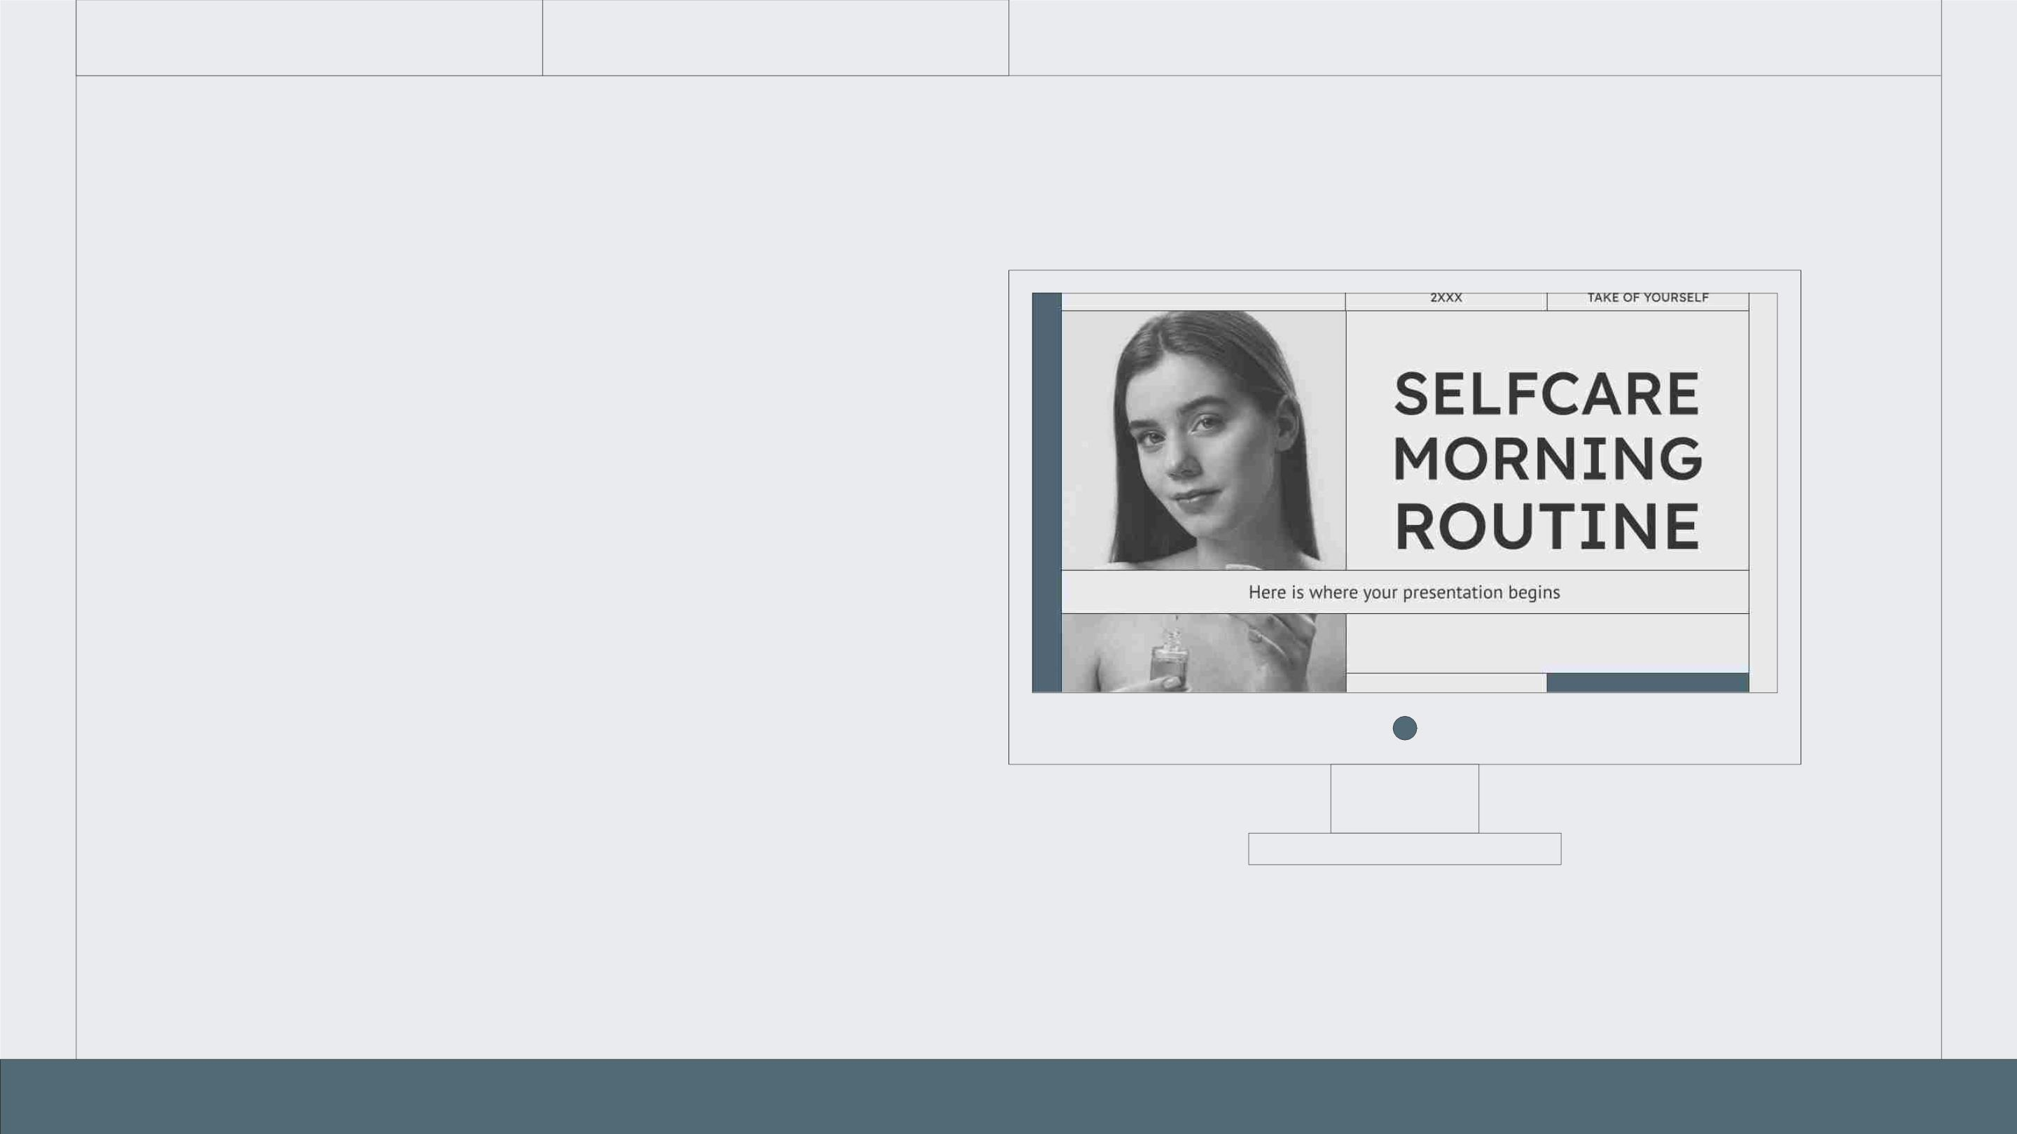
COMPUTER
MOCKUP
You can replace the image on the
screen with your own work. Just
right-click on it and select
“Replace image”

Slide 26
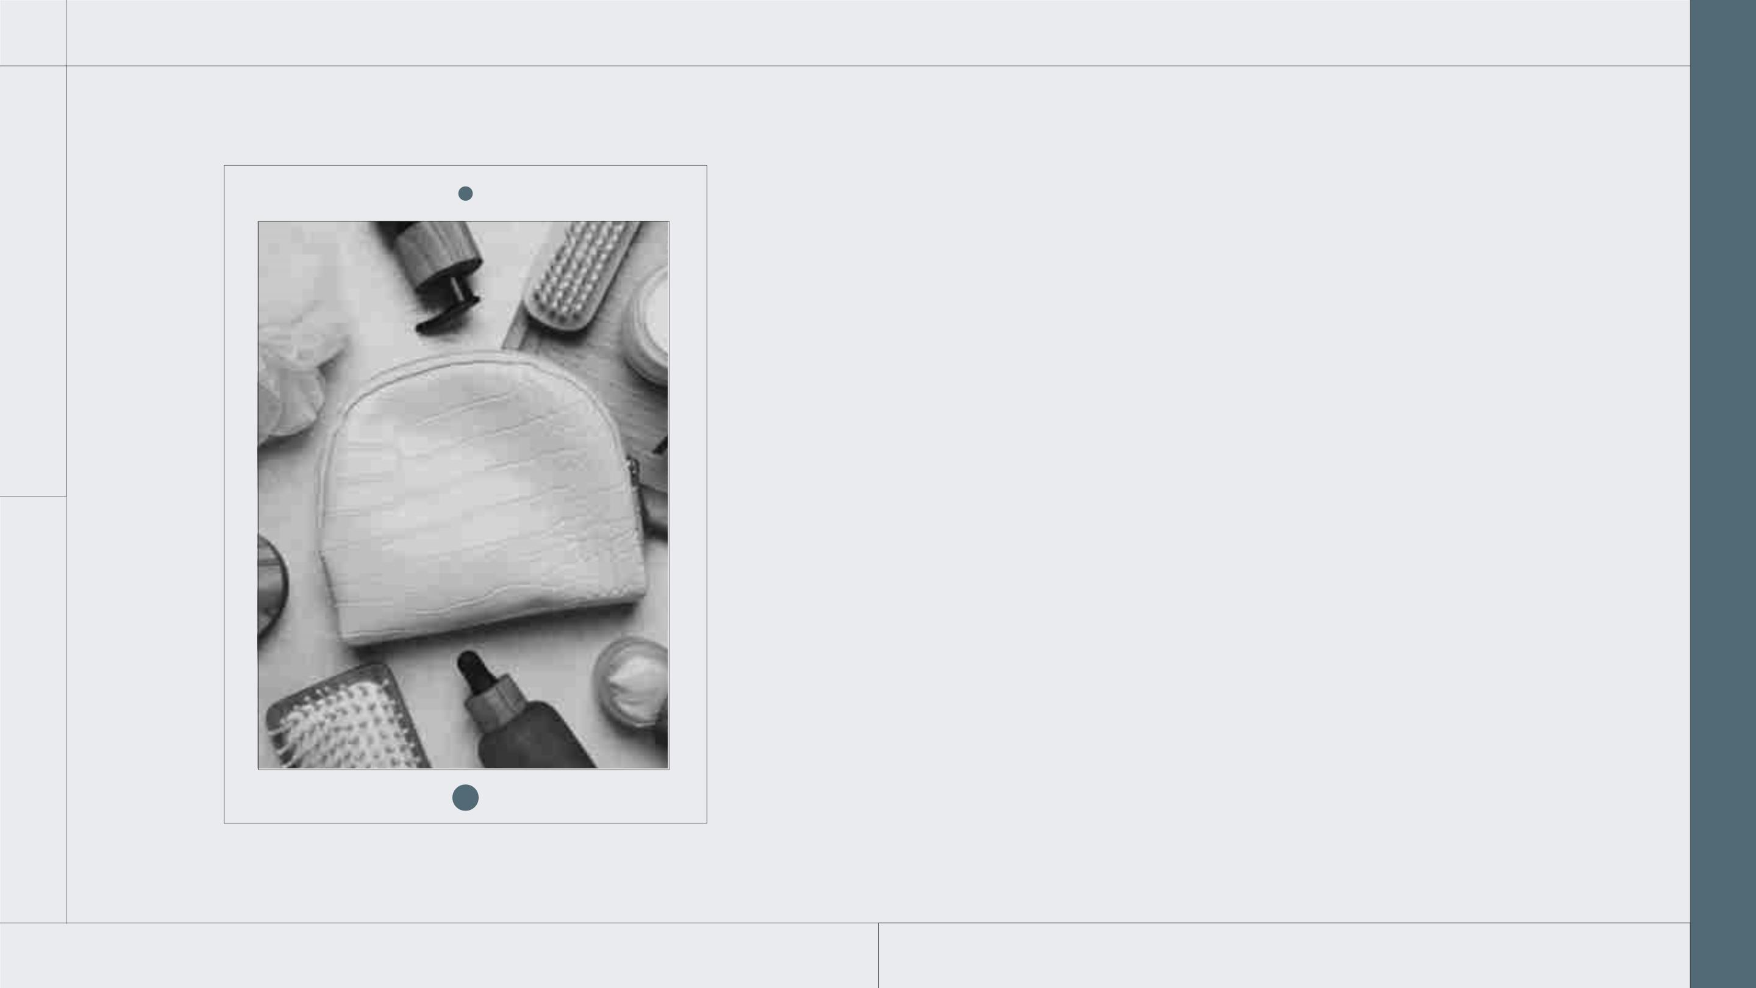
TABLET
MOCKUP
You can replace the image on the
screen with your own work. Just
right-click on it and select
“Replace image”

Slide 27
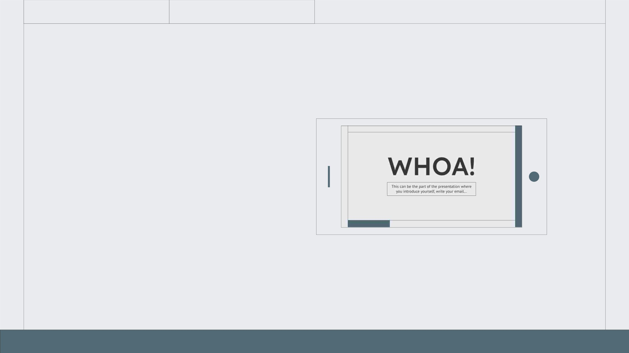
PHONE
MOCKUP
You can replace the image on the
screen with your own work. Just
right-click on it and select
“Replace image”

Slide 28
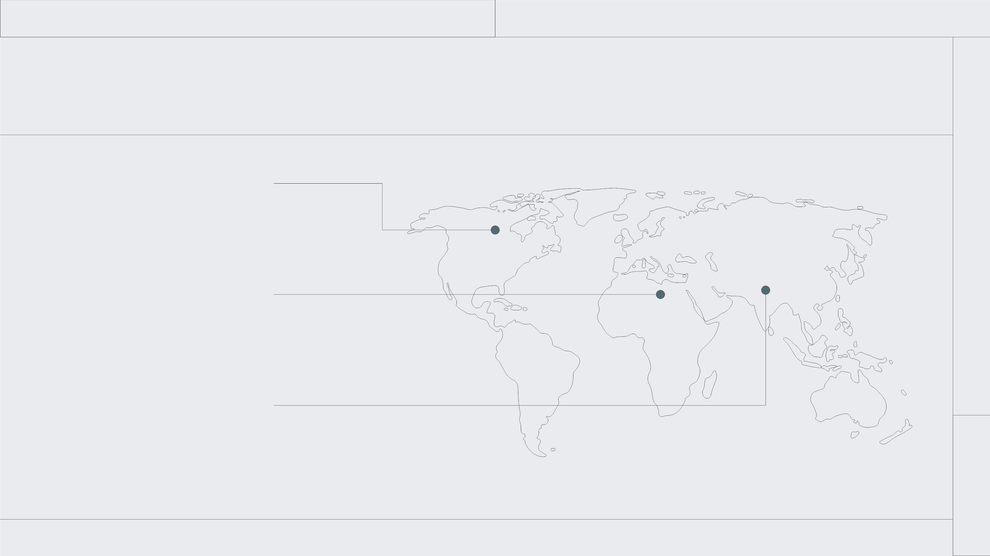
THIS IS A MAP
MERCURY
It’s the closest planet to the
Sun and the smallest one
VENUS
It has a nice name and is the
second planet from the Sun
JUPITER
Jupiter is the biggest planet in
the Solar System

Slide 29
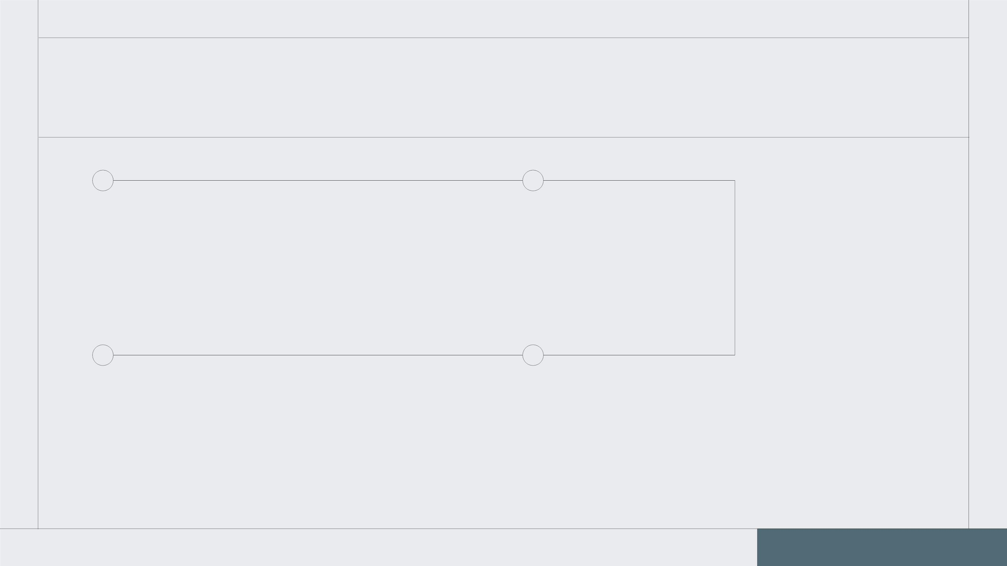
MORNING TIMELINE
MERCURY
VENUS
Mercury is the closest planet to
the Sun and the smallest one
Venus has a nice name and is the
second planet from the Sun
JUPITER
EARTH
Jupiter is the biggest planet in
the Solar System
Earth is the third planet from the
Sun and harbors life

Slide 30
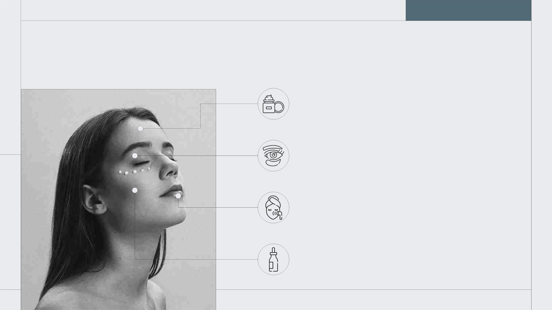
THIS IS AN INFOGRAPHIC
VENUS
Venus has a beautiful name
EARTH
Earth is the third planet from the Sun
MARS
Despite being red, Mars is a cold place
JUPITER
Jupiter is a huge gas giant

Slide 31
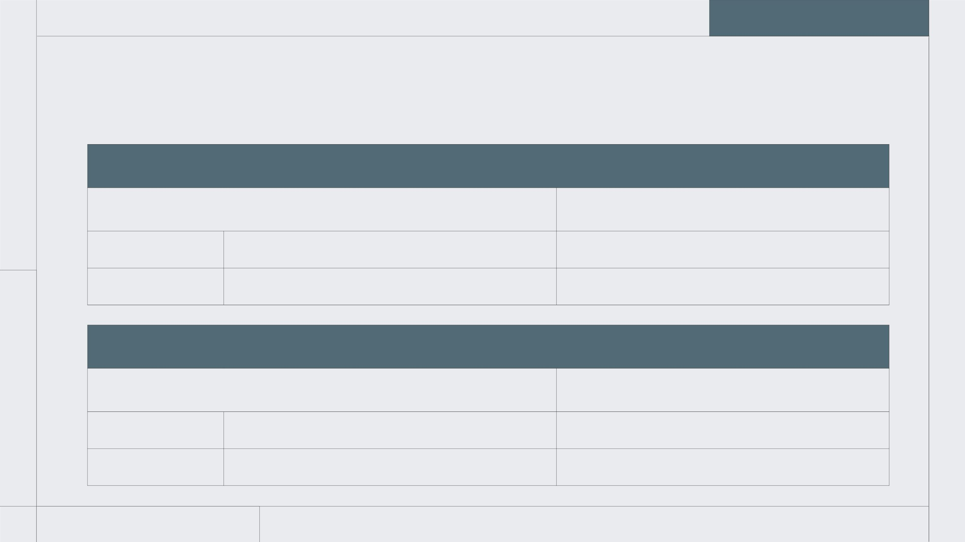
TABLES REPRESENT YOUR DATA
MORNING
STEPS
PRODUCTS
Product 1
1
2
Neptune is an ice giant
Saturn is the ringed planet
Product 2
NIGHT
STEPS
PRODUCTS
Product 1
1
2
Jupiter doesn’t have a solid surface
Mars is full of iron oxide dust
Product 2

Slide 32
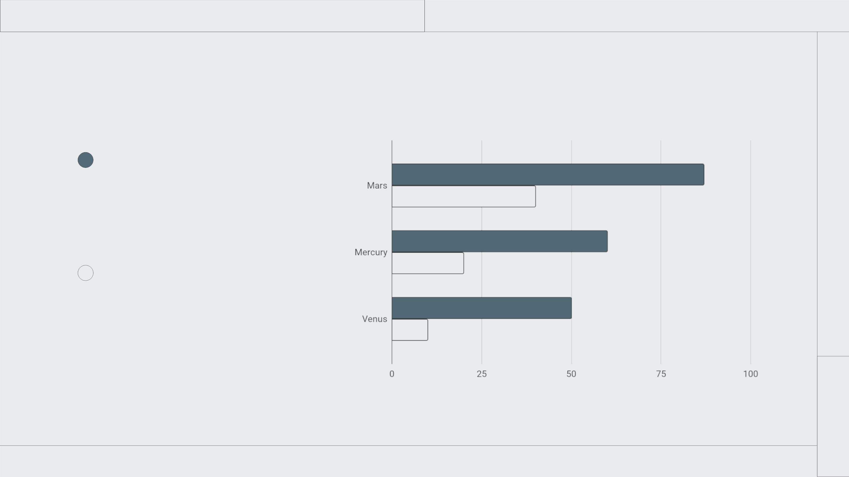
YOU CAN USE THIS GRAPH
NEPTUNE
It's the fourth-largest planet in
the Solar System
SATURN
Saturn is composed mostly of
hydrogen and helium
Follow the link in the graph to modify its data and then paste the new one here. For more info, click here

Slide 33
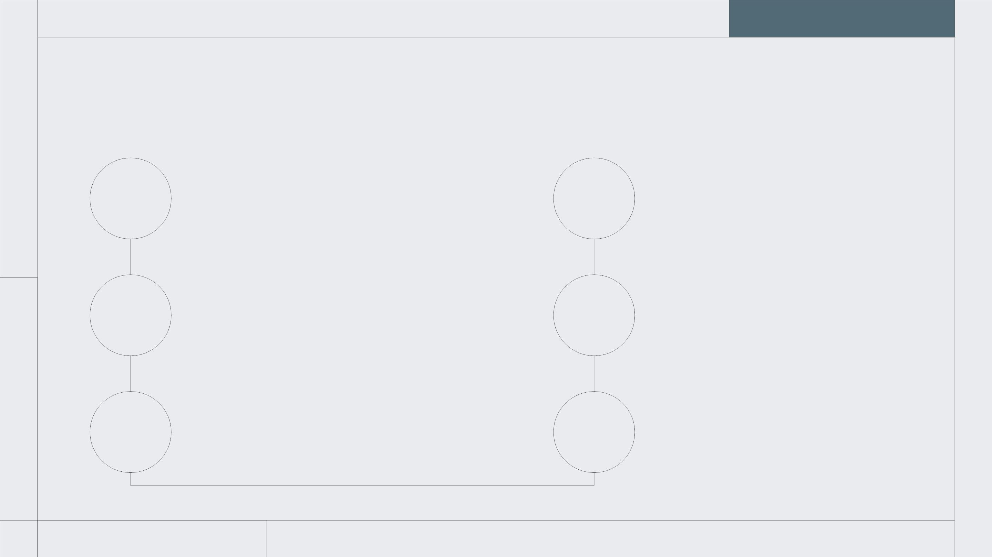
NIGHT ROUTINE
VENUS
Venus is the second planet
from the Sun
EARTH
Earth is the third planet
from the Sun
01
02
03
06
05
04
JUPITER
Jupiter is the biggest
planet in the Solar System
MARS
Despite being red, Mars is
actually a cold place
SATURN
Saturn is composed mostly
of hydrogen and helium
NEPTUNE
Neptune is the farthest
planet from the Sun

Slide 34
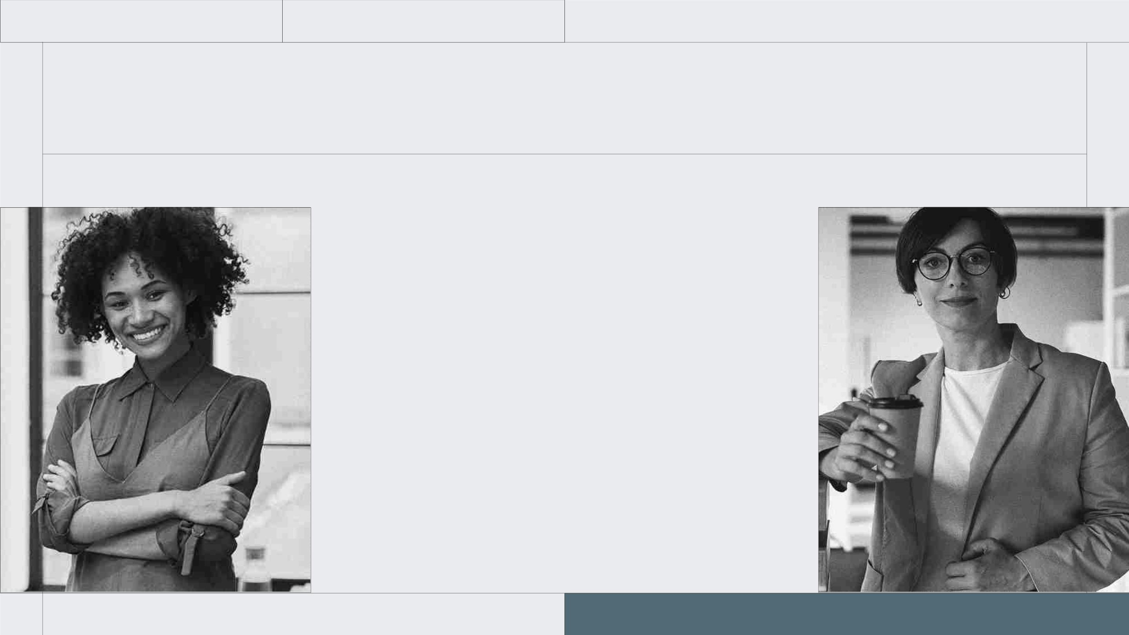
OUR TEAM
KALIYAH
HARRIS
SOFIA
HILL
You can speak a
bit about this
person here
You can speak a
bit about this
person here

Slide 35
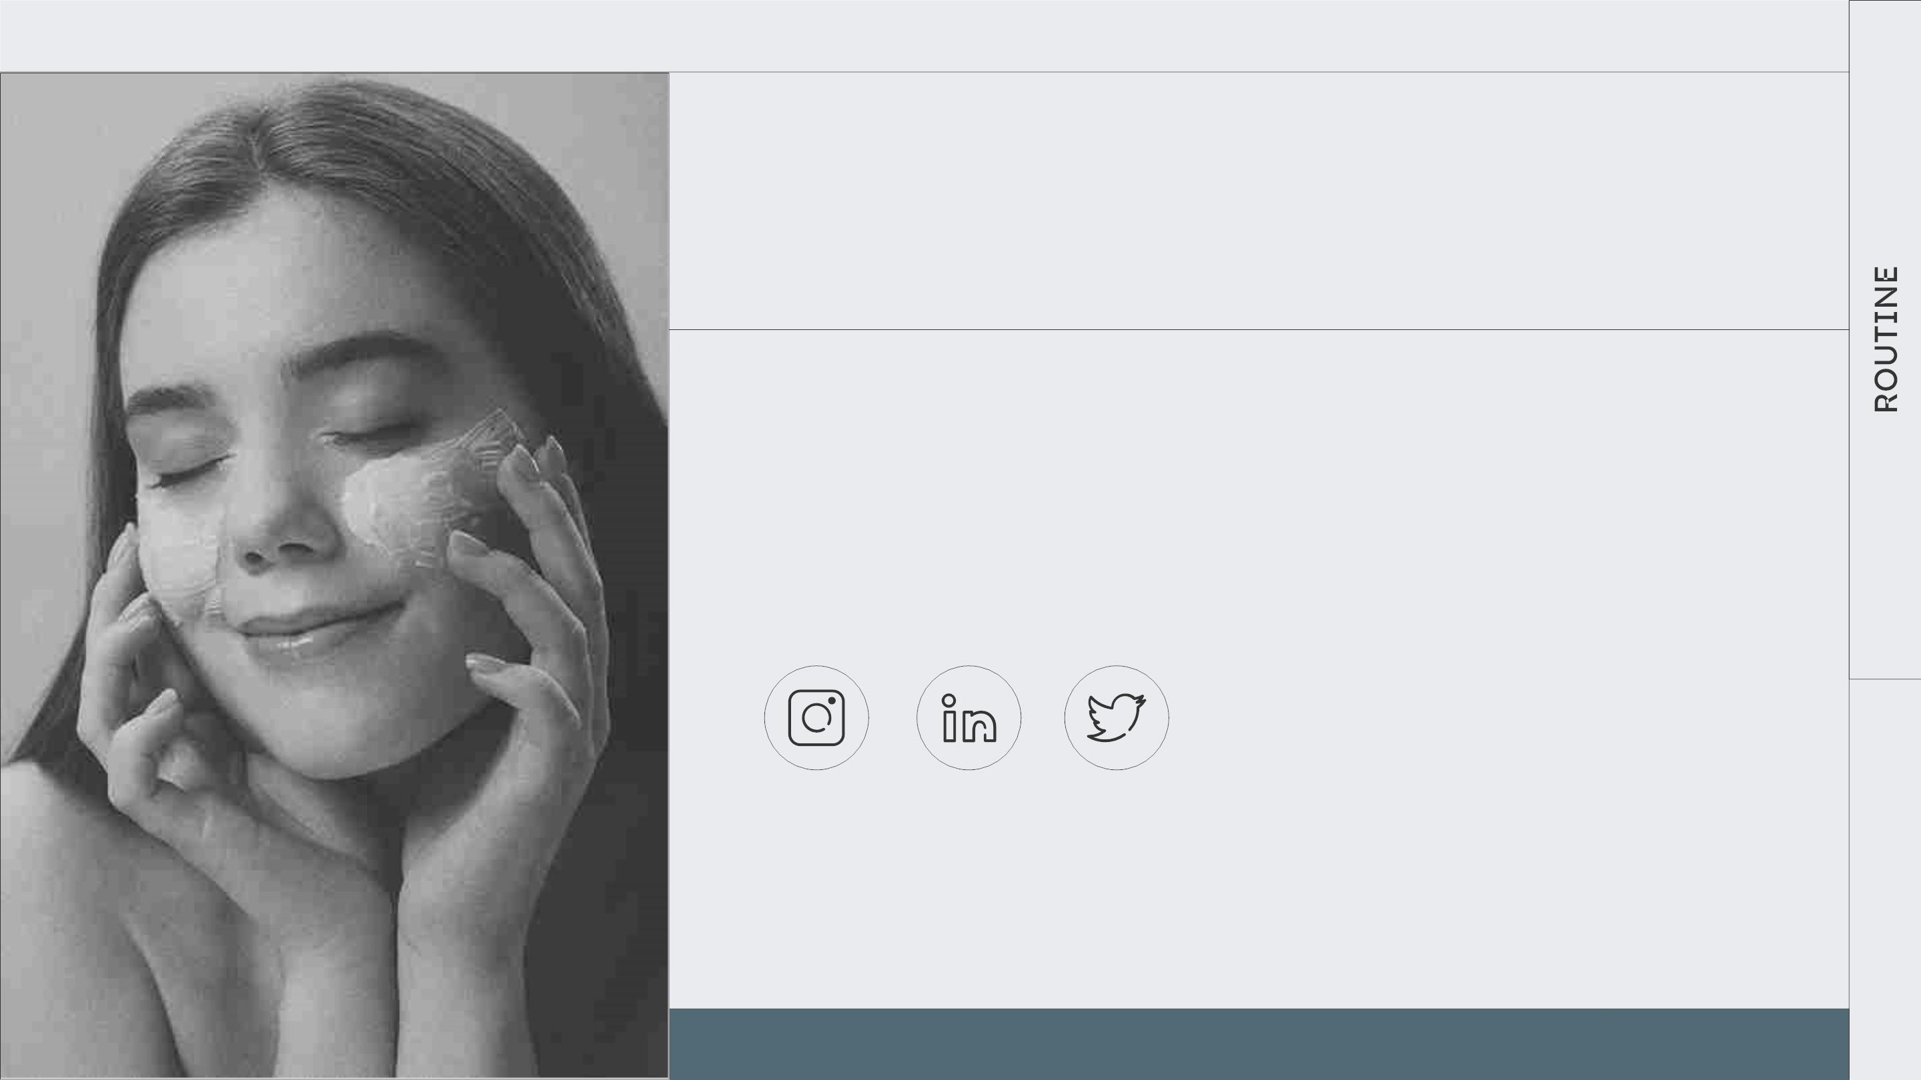
THANKS!
DO YOU HAVE ANY QUESTIONS?
youremail@freepik.com
+34 654 321 432
yourwebsite.com
CREDITS: This presentation template was created by Slidesgo, and
includes icons by Flaticon, and infographics & images byFreepik
Please keep this slide for attribution

Slide 36
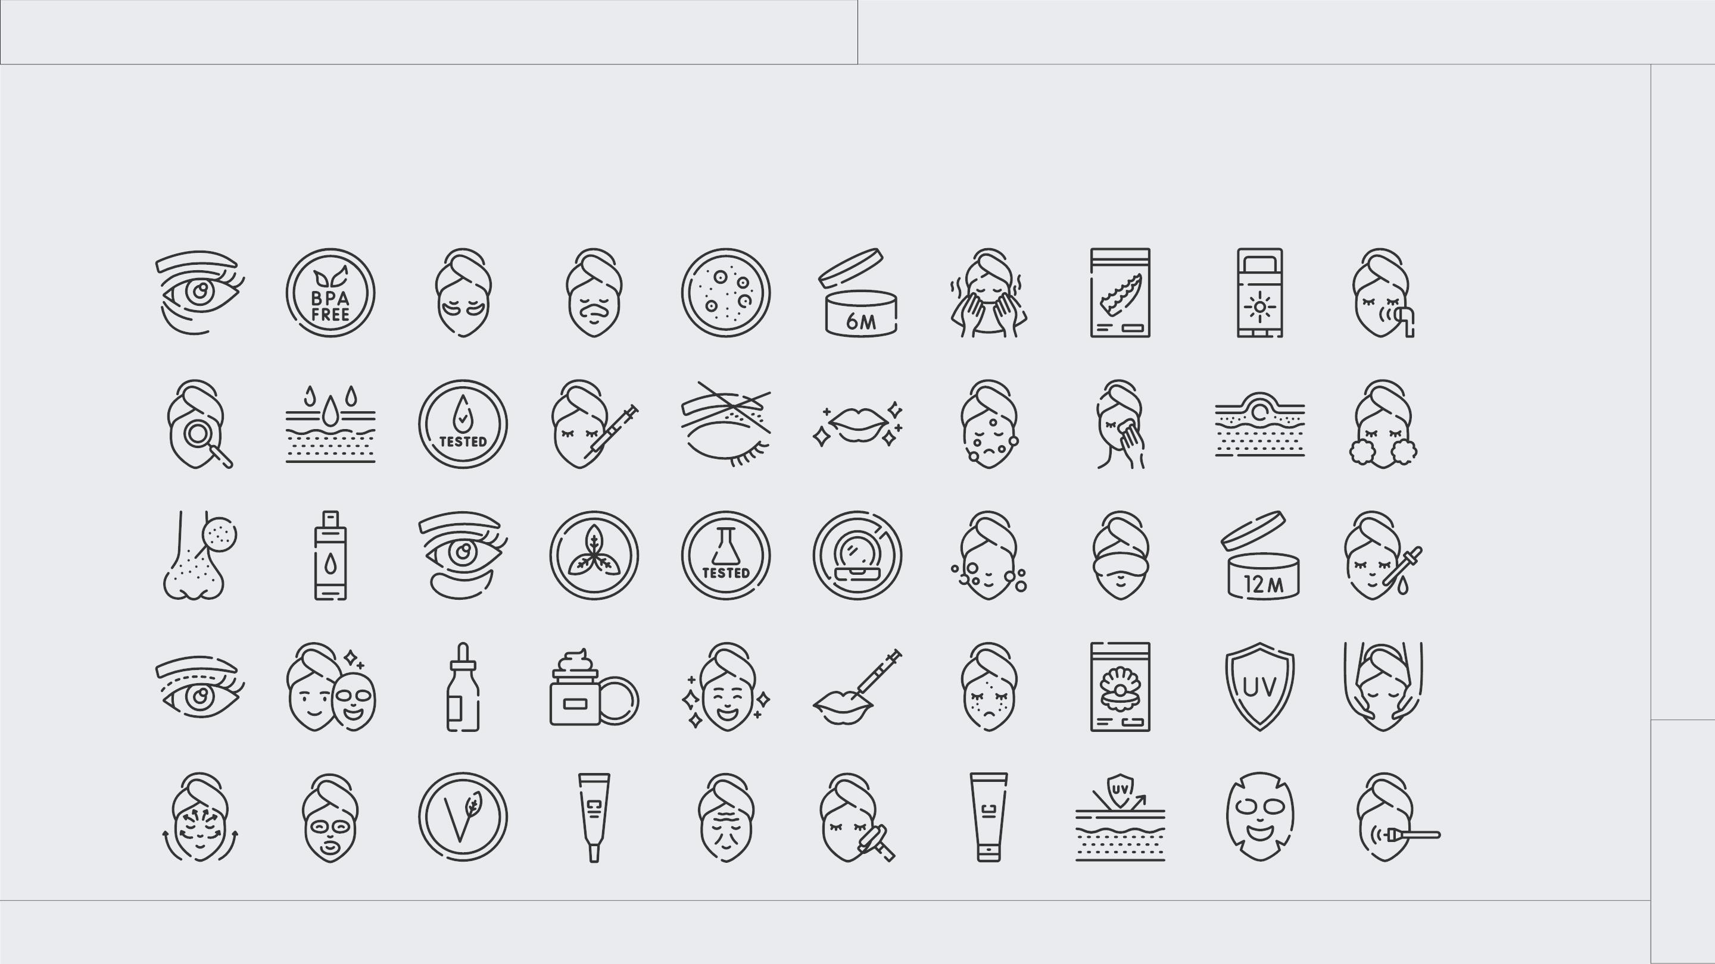
ICON PACK

Slide 37
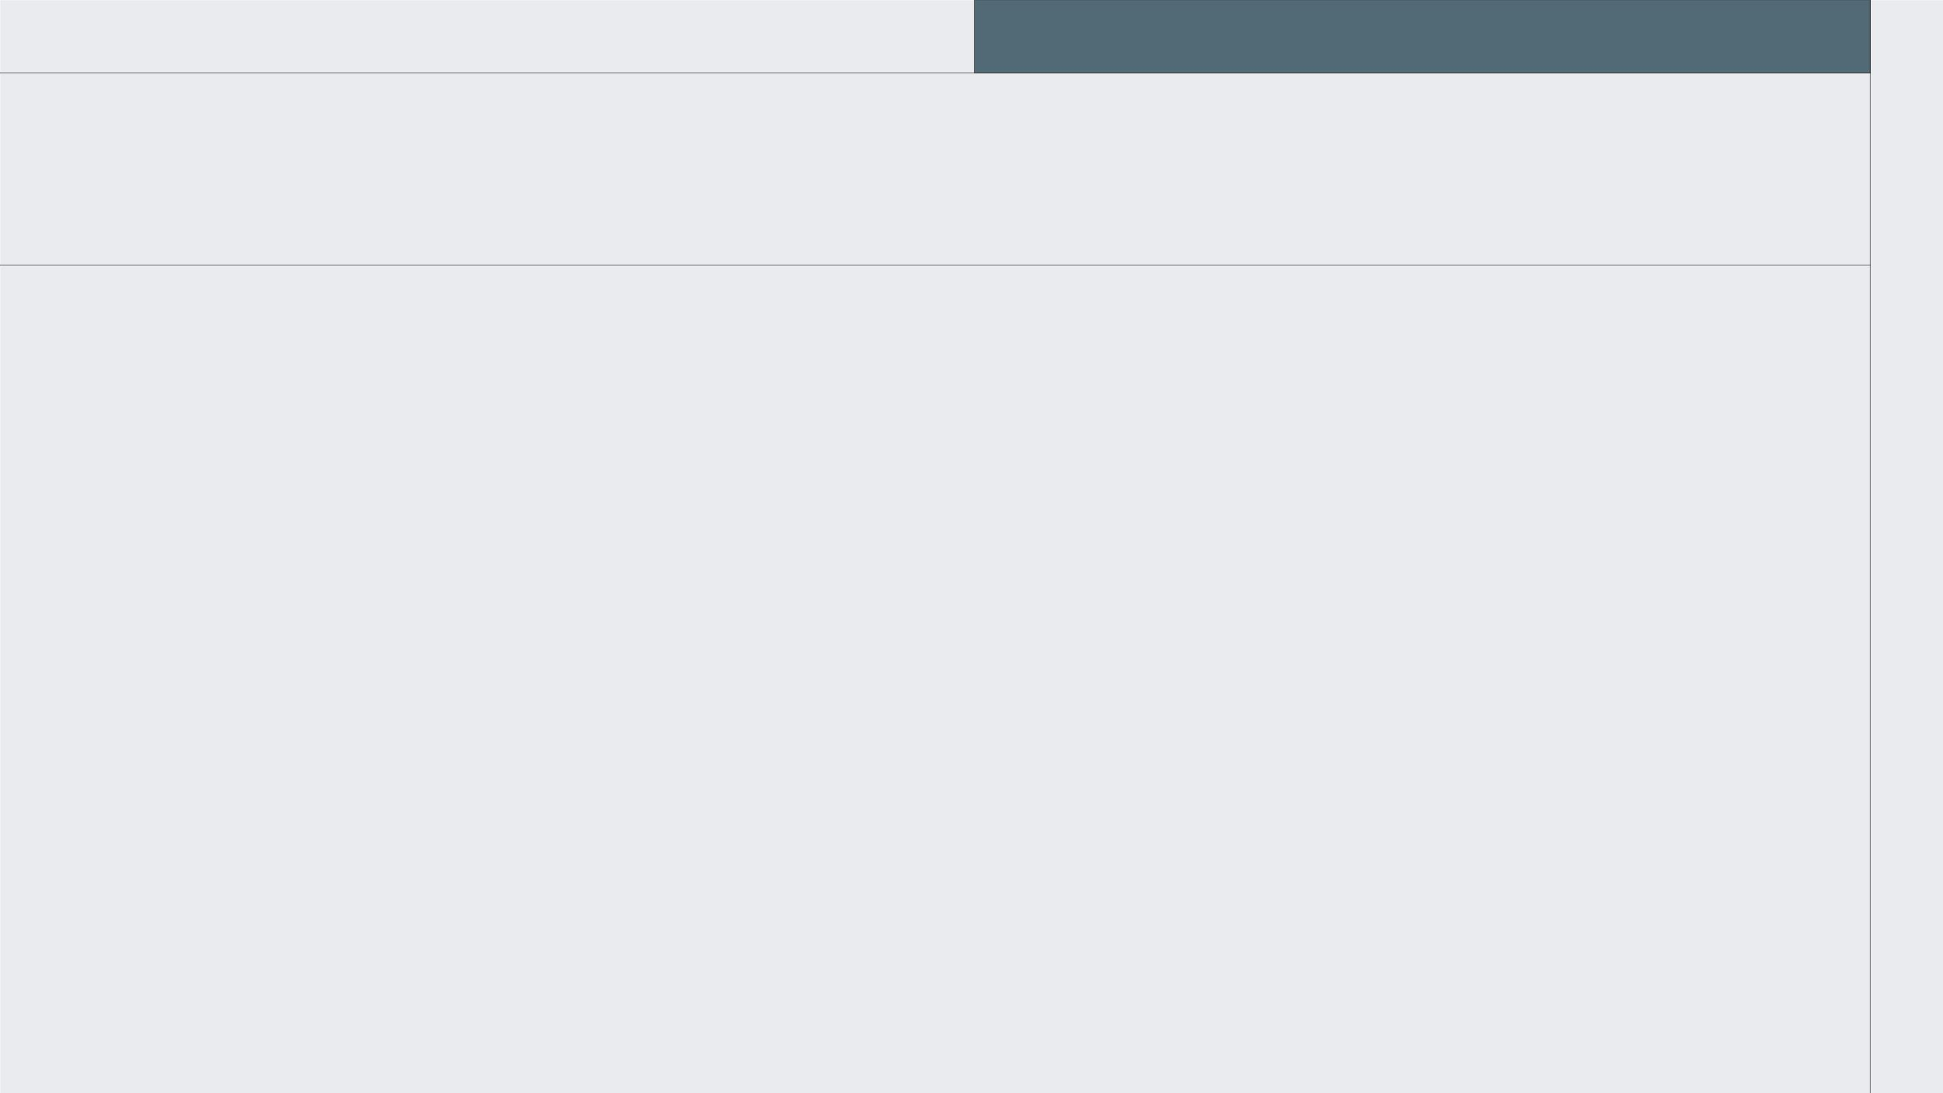
ALTERNATIVE RESOURCES
Here’s an assortment of alternative resources whose style fits that of this template:
PHOTOS
● Top view toilet bag on table
● Front view woman using lip gloss
● Young male doing selfcare routine I
● Young male doing selfcare routine II
● Man doing his face care routine
● Close up on selfcare routine products
● Toilet bag with products arrangement top view

Slide 38
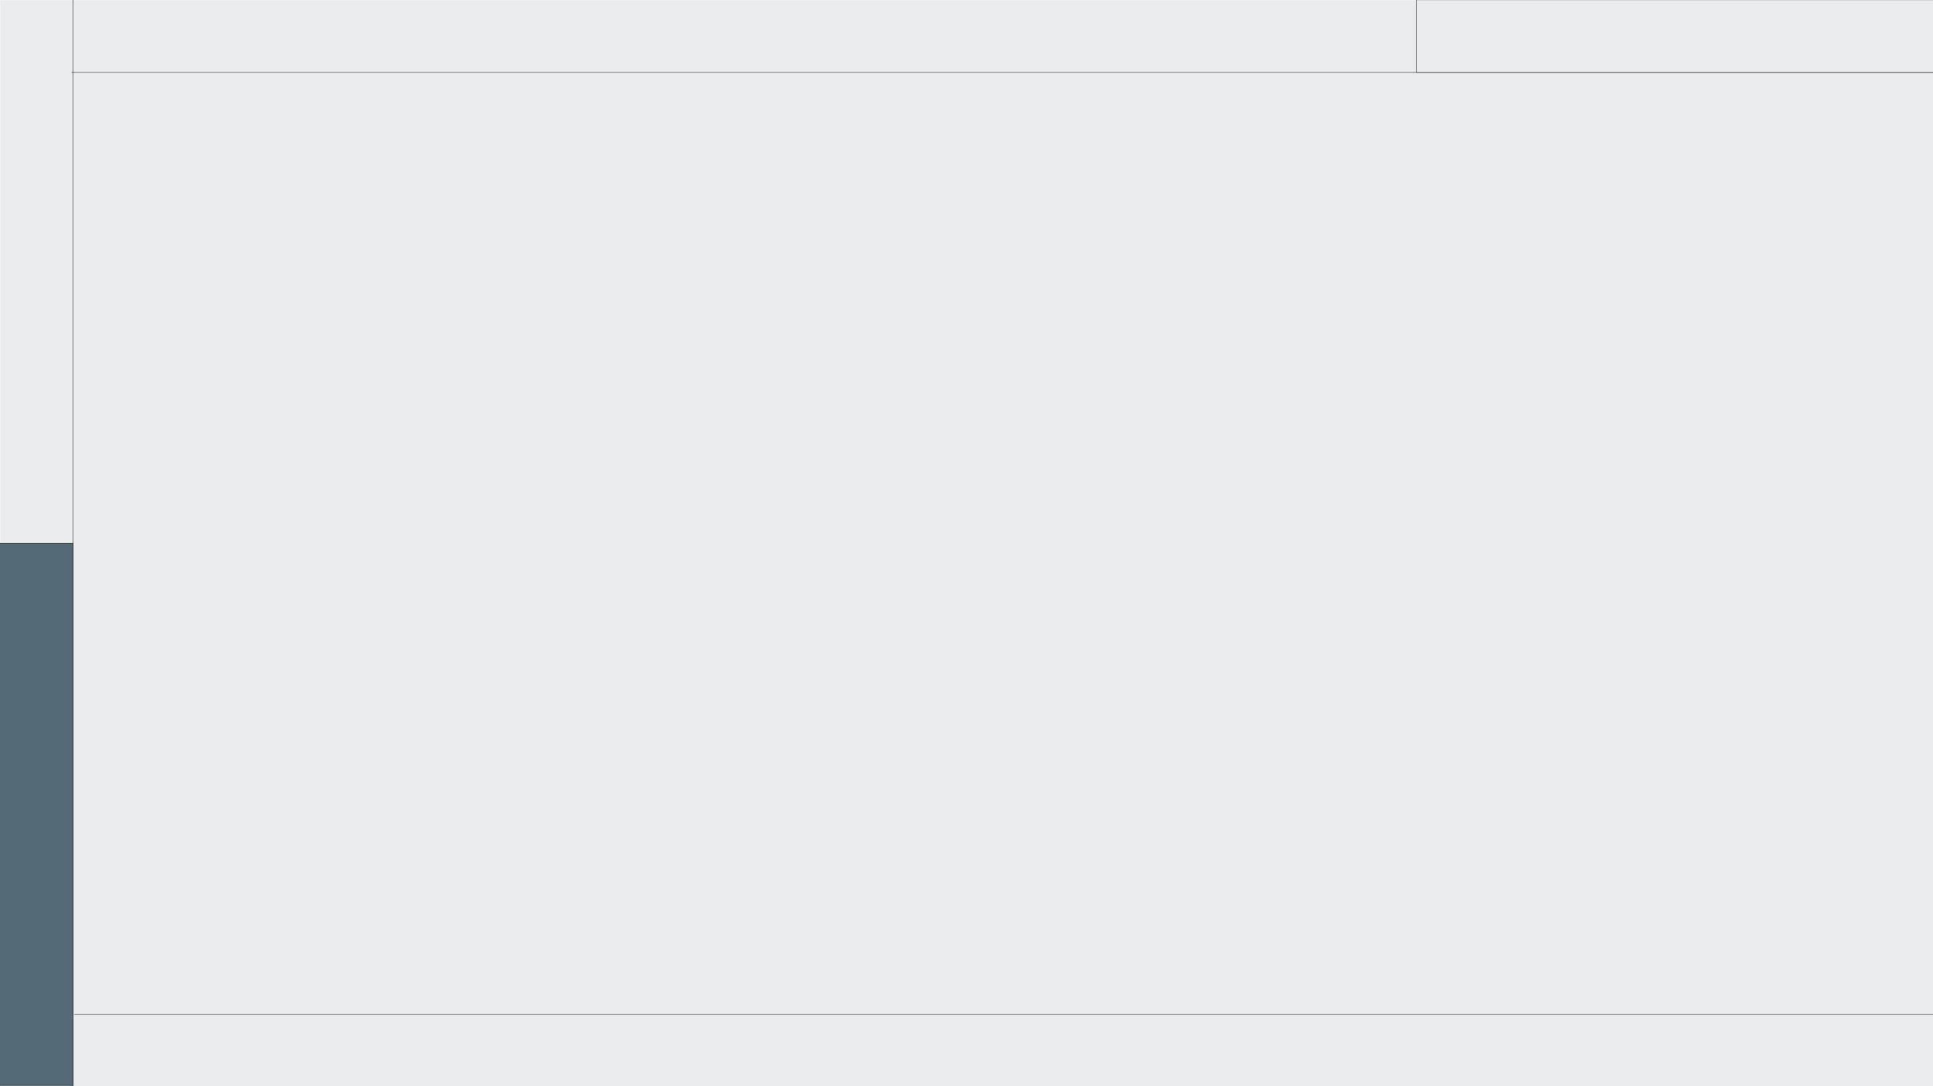
RESOURCES
Did you like the resources on this template?
Get them for free at our other websites:
● High angle toilet bag on cabinet
● Toilet bag and items on table
arrangement
● Top view toilet bag with products
arrangement
PHOTOS
● Front view woman holding coffee cup
● Close up on young businesswoman
● Side view adult holding toilet bag
● Woman using eye cream side view
● Young male doing selfcare routine
● Close up on selfcare routine products
● Flat lay toilet bag on table
● Toilet bag with products arrangement
flat lay
● Medium shot young woman using serum
● Smiley woman with face cream front
view
● Toilet bag with products assortment
● Young male doing selfcare routine
● Toilet bag and items on table
● Woman using eye cream side view

Slide 39

Instructions for use
If you have a free account, in order to use this template, you must credit Slidesgo by keeping the Thanks slide. Please
refer to the next slide to read the instructions for premium users.
As a Free user, you are allowed to:
● Modify this template.
● Use it for both personal and commercial projects.
You are not allowed to:
● Sublicense, sell or rent any of Slidesgo Content (or a modified version of Slidesgo Content).
● Distribute Slidesgo Content unless it has been expressly authorized by Slidesgo.
● Include Slidesgo Content in an online or offline database or file.
● Offer Slidesgo templates (or modified versions of Slidesgo templates) for download.
● Acquire the copyright of Slidesgo Content.
For more information about editing slides, please read our FAQs or visit our blog:
https://slidesgo.com/faqs and https://slidesgo.com/slidesgo-school

Slide 40
Instructions for use (premium users)
As a Premium user, you can use this template without attributing Slidesgo or keeping the Thanks slide.
You are allowed to:
● Modify this template.
● Use it for both personal and commercial purposes.
● Hide or delete the “Thanks” slide and the mention to Slidesgo in the credits.
● Share this template in an editable format with people who are not part of your team.
You are not allowed to:
● Sublicense, sell or rent this Slidesgo Template (or a modified version of this Slidesgo Template).
● Distribute this Slidesgo Template (or a modified version of this Slidesgo Template) or include it in a database or in
any other product or service that offers downloadable images, icons or presentations that may be subject to
distribution or resale.
● Use any of the elements that are part of this Slidesgo Template in an isolated and separated way from this
Template.
● Register any of the elements that are part of this template as a trademark or logo, or register it as a work in an
intellectual property registry or similar.
For more information about editing slides, please read our FAQs or visit our blog:
https://slidesgo.com/faqs and https://slidesgo.com/slidesgo-school

Slide 41
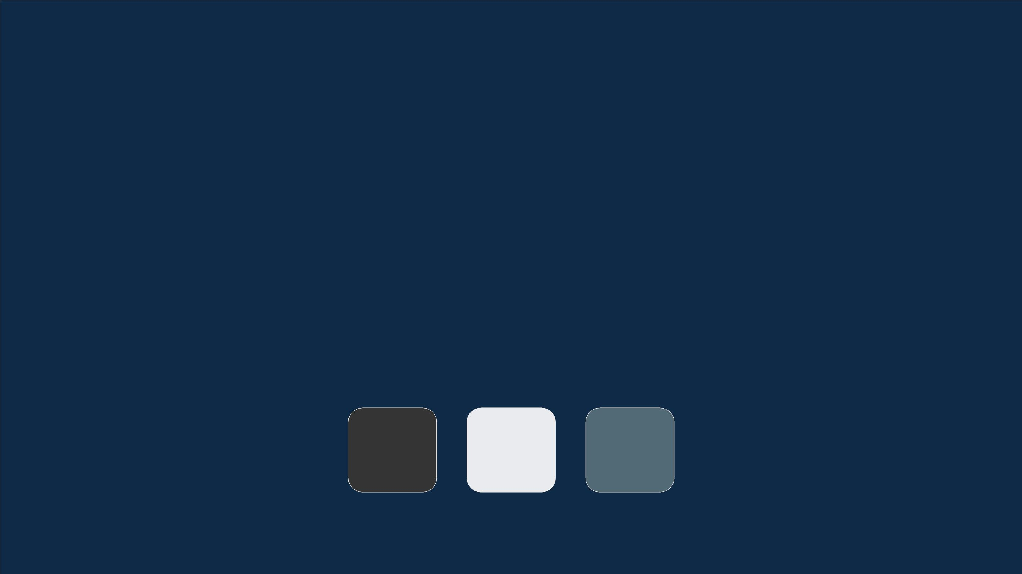
Fonts & colors used
This presentation has been made using the following fonts:
Lexend
(https://fonts.google.com/specimen/Lexend)
PT Sans
(https://fonts.google.com/specimen/PT+Sans)
#343433
#eaebee
#526a75

Slide 42
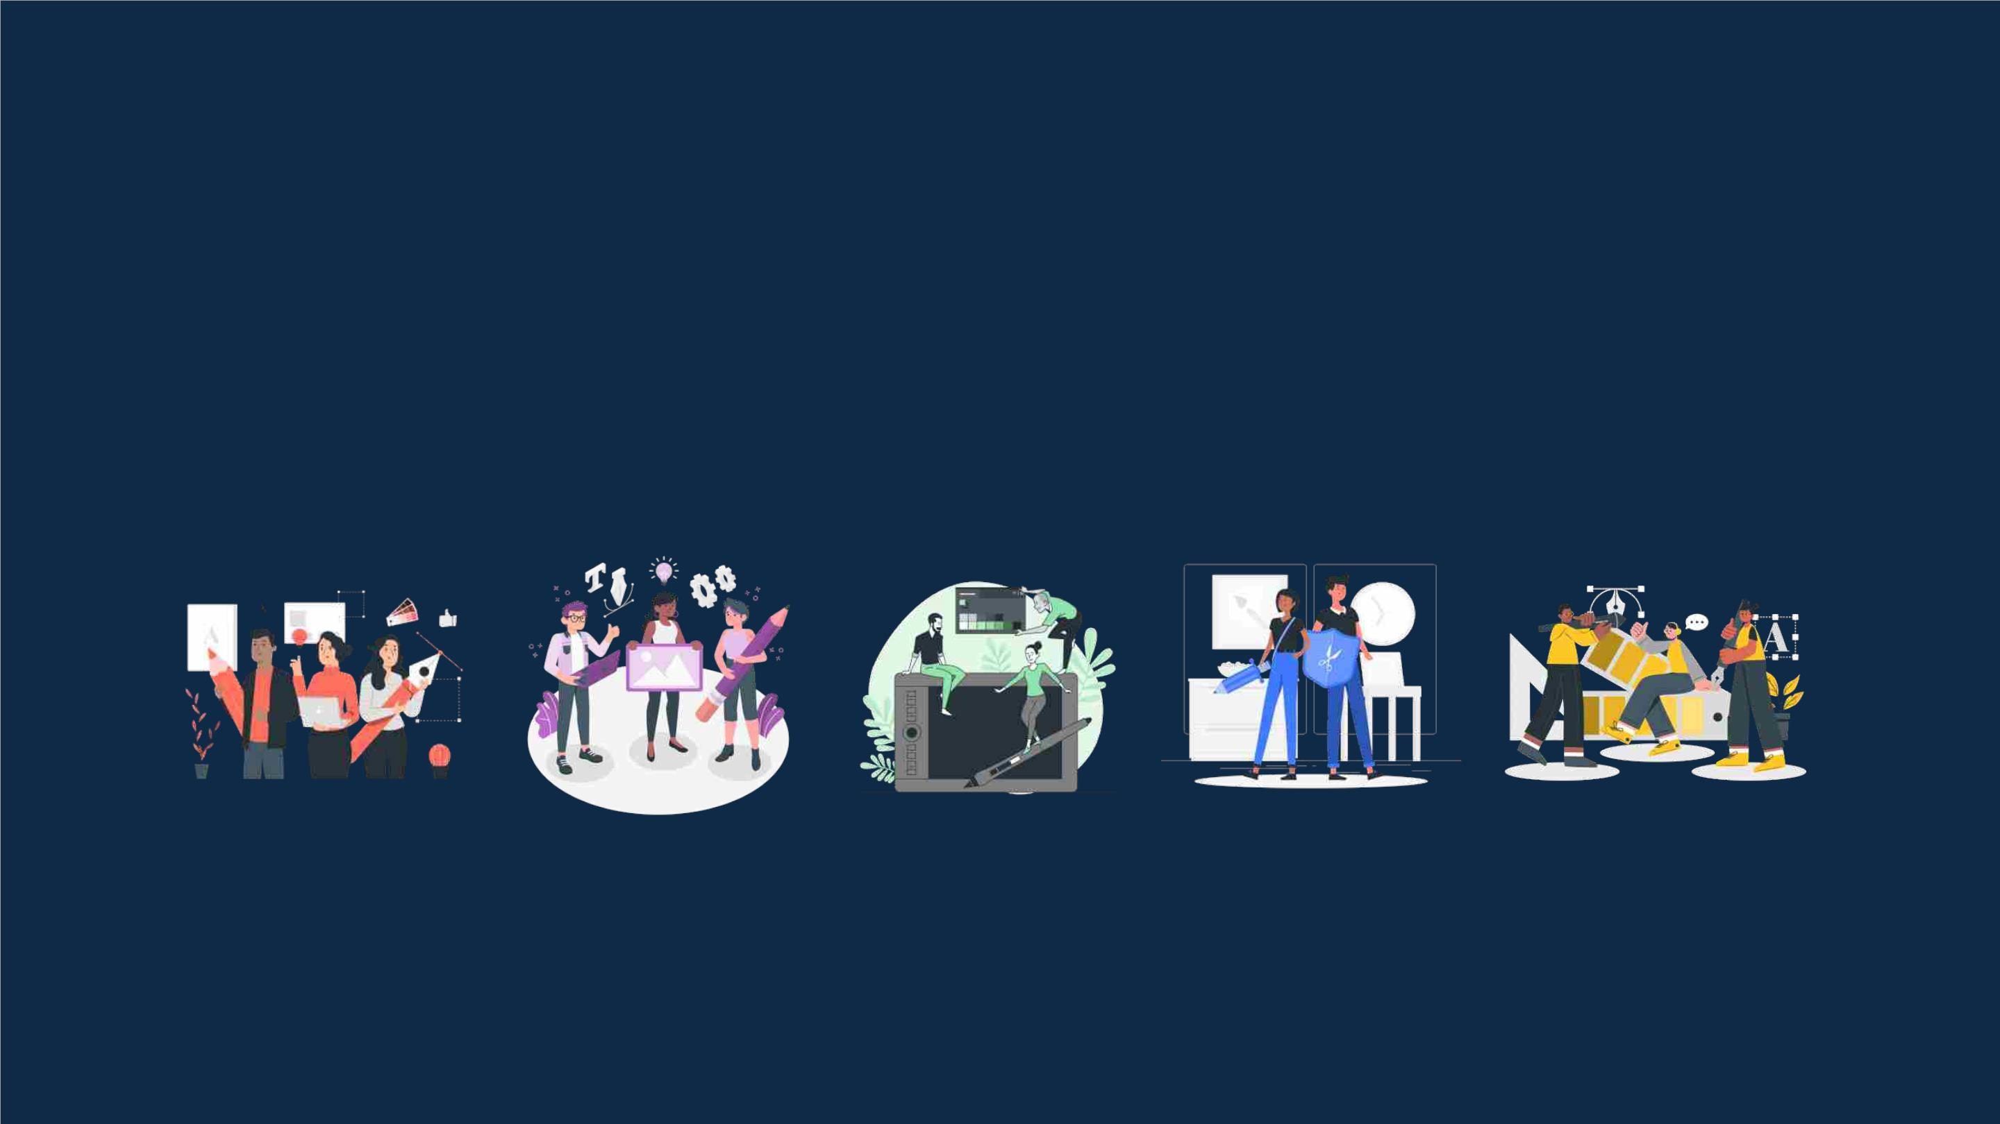
Storyset
Create your Story with our illustrated concepts. Choose the style you like the most, edit its
colors, pick the background and layers you want to show and bring them to life with the
animator panel! It will boost your presentation. Check out how it works.
Pana
Amico
Bro
Rafiki
Cuate

Slide 43
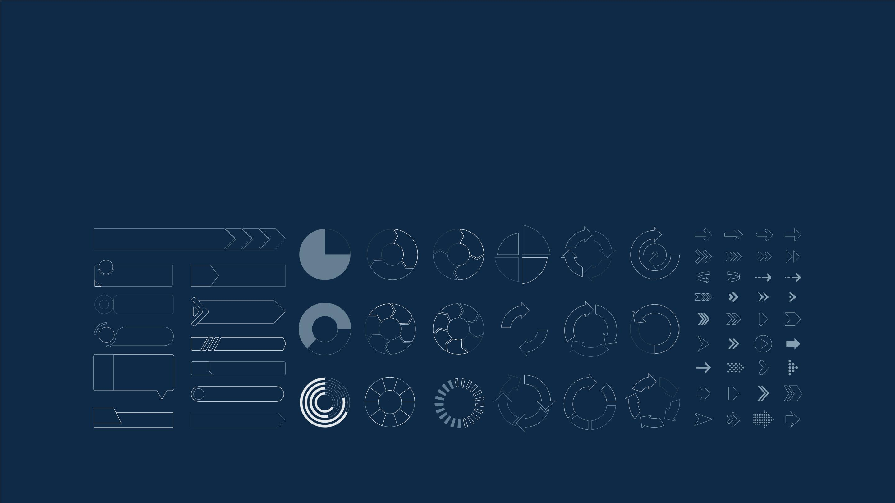
Use our editable graphic resources...
You can easily resize these resources without losing quality. To change the color, just ungroup the resource and click on
the object you want to change. Then, click on the paint bucket and select the color you want. Group the resource again
when you’re done. You can also look for more infographics on Slidesgo.

Slide 44
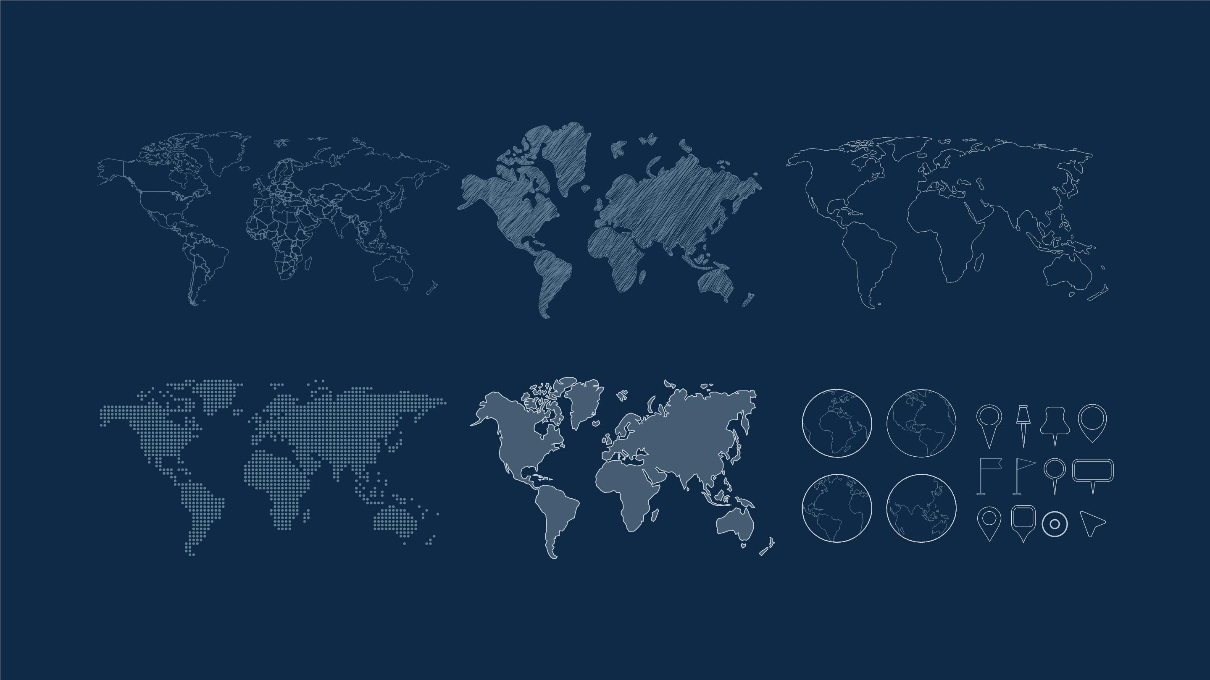

Slide 45
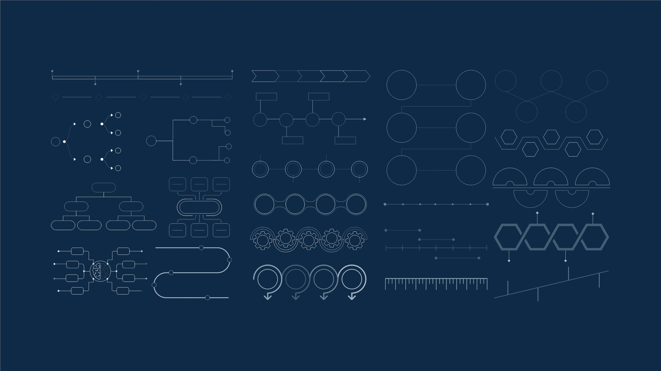

Slide 46
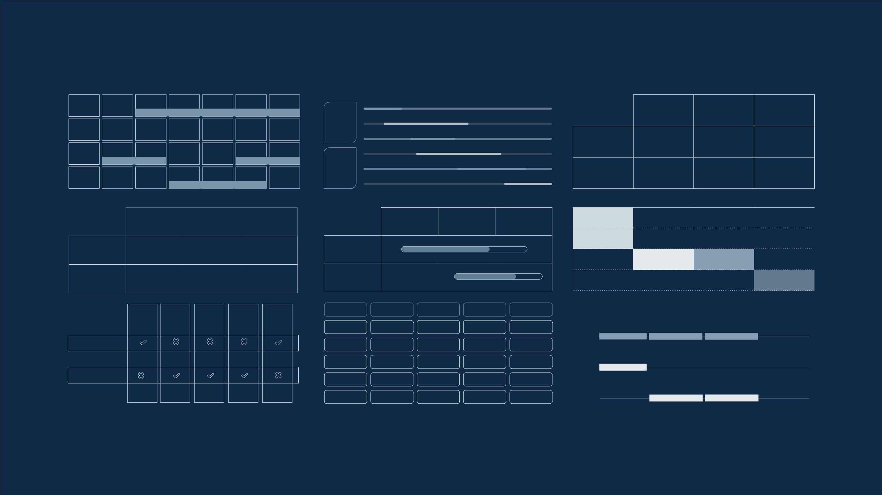
JANUARY
FEBRUARY
MARCH
APRIL
MAY
JUNE
PHASE 1
Task 1
Task 2
PHASE 2
Task 1
Task 2
JANUARY
FEBRUARY
MARCH
APRIL
PHASE 1
Task 1
Task 2

Slide 47


Slide 48
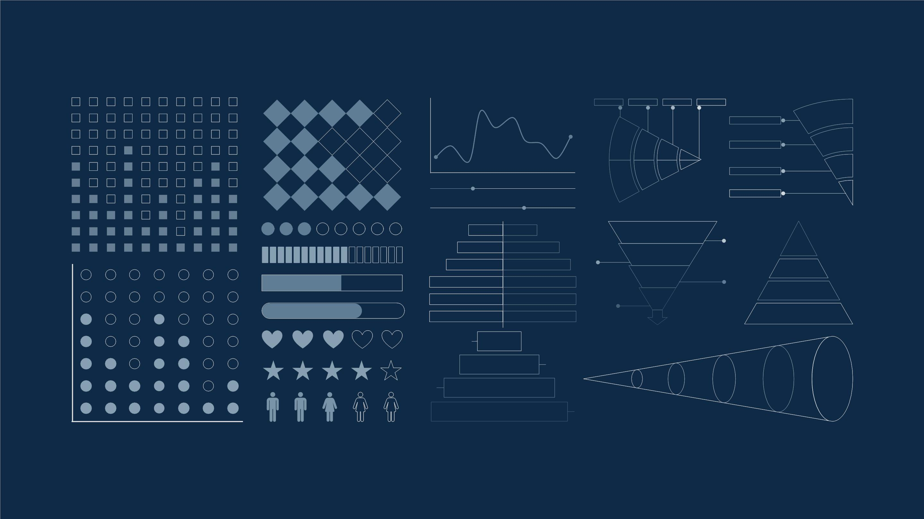

Slide 49

...and our sets of editable icons
You can resize these icons without losing quality.
You can change the stroke and fill color; just select the icon and click on the paint bucket/pen.
In Google Slides, you can also use Flaticon’s extension, allowing you to customize and add even more icons.

Slide 50
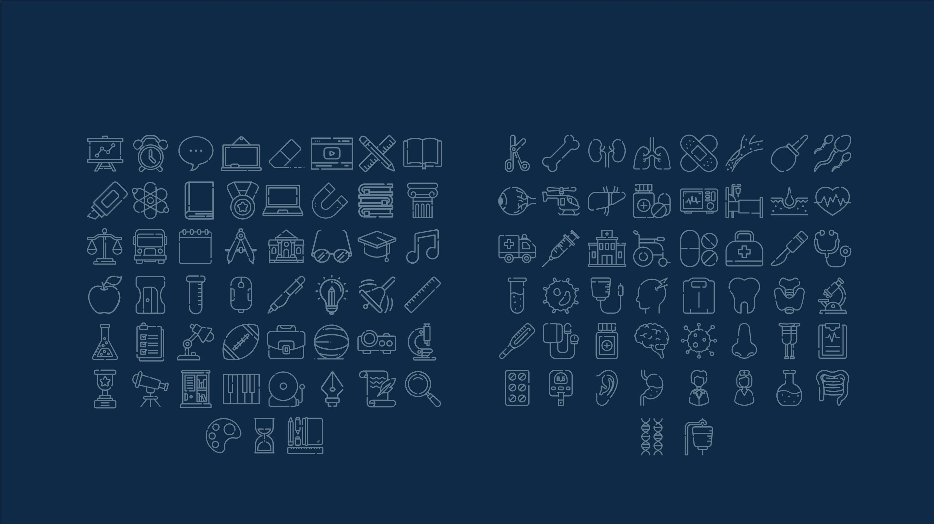
Educational Icons
Medical Icons

Slide 51

Business Icons
Teamwork Icons

Slide 52
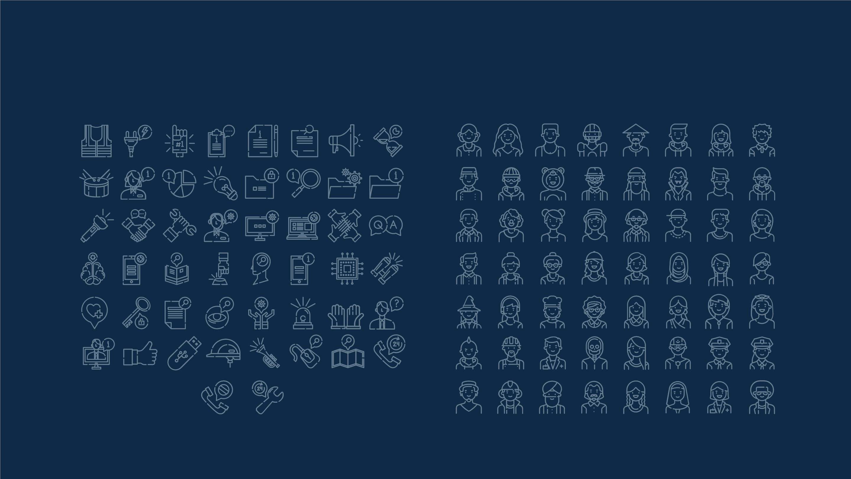
Help & Support Icons
Avatar Icons

Slide 53
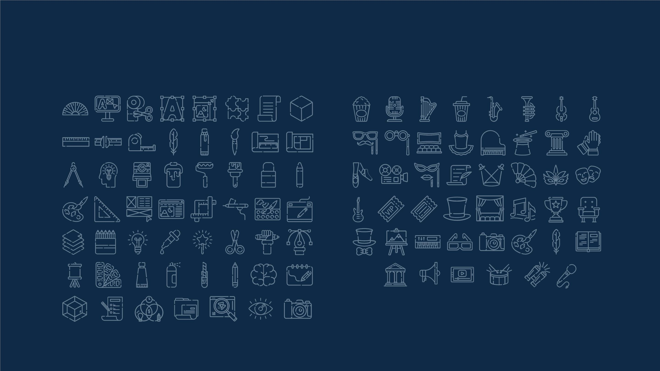
Creative Process Icons Performing Arts Icons

Slide 54
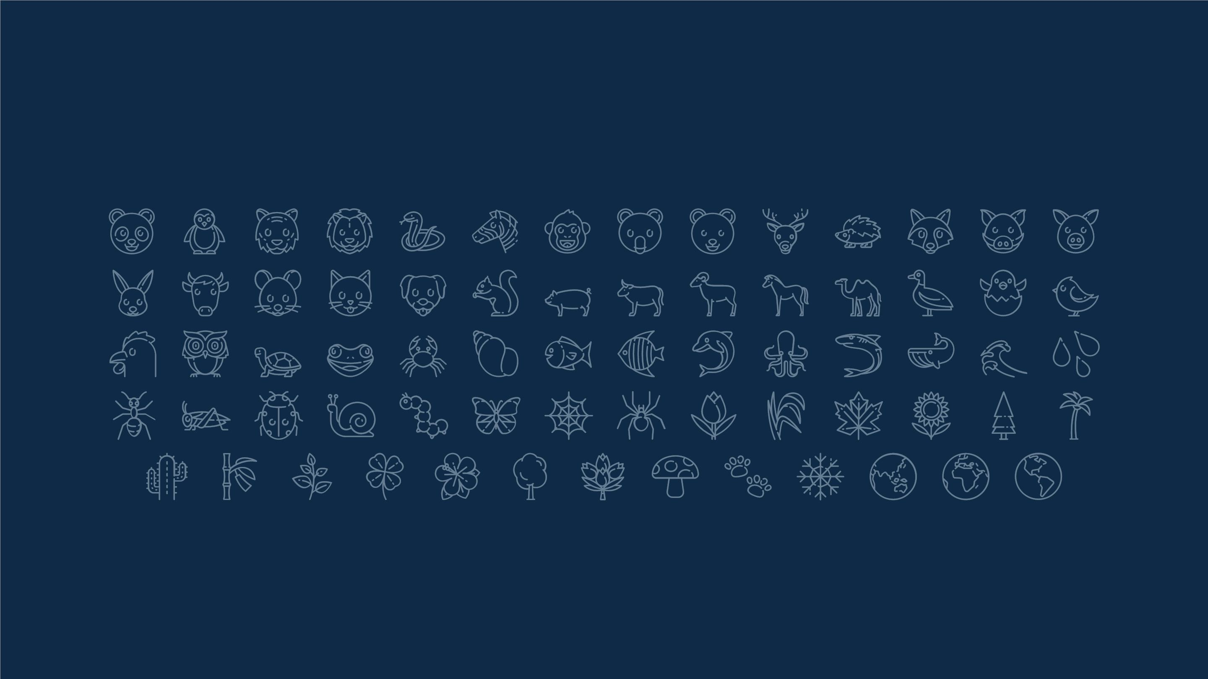
Nature Icons

Slide 55

SEO & Marketing Icons

Slide 56


